Slide 1
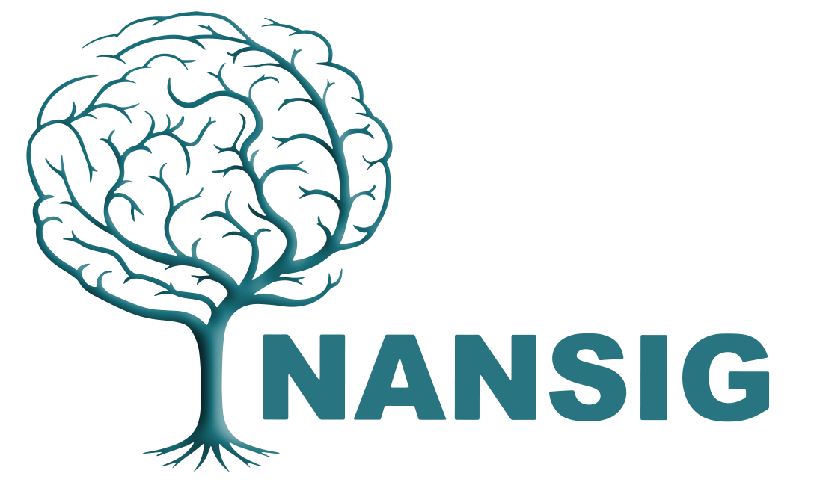
Opportunities in stroke medicine: a personal view
David Werring
Professor of clinical neurology and honorary consultant neurologist
UCL Queen Square Institute of Neurology
National Hospital for Neurology and Neurosurgery
Queen Square, London
President, British and Irish Association of Stroke Physicians (BIASP)

Slide 2
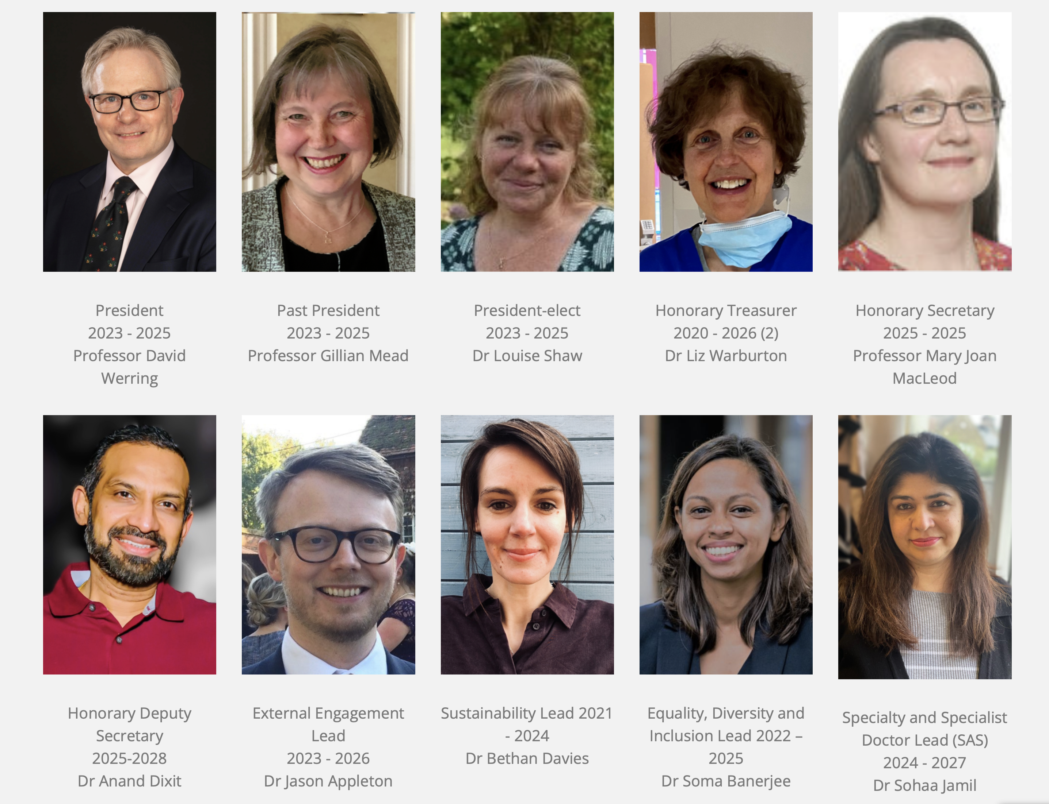
BIASP’s mission is to advance stroke medicine for the good of the public, patients and professionals
Student membership is completely free!

Slide 3
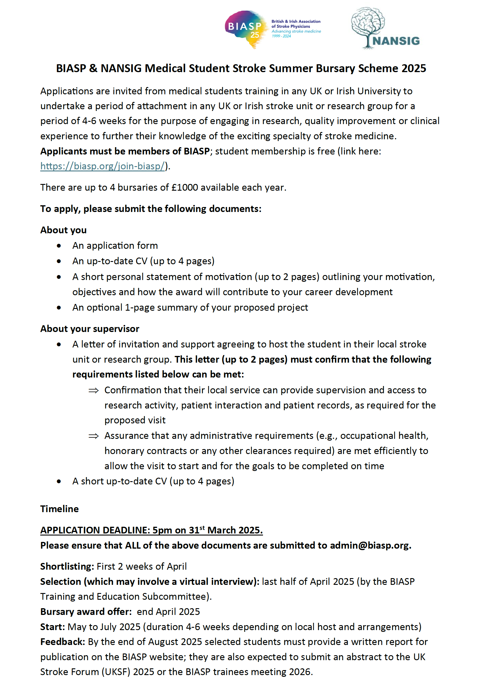

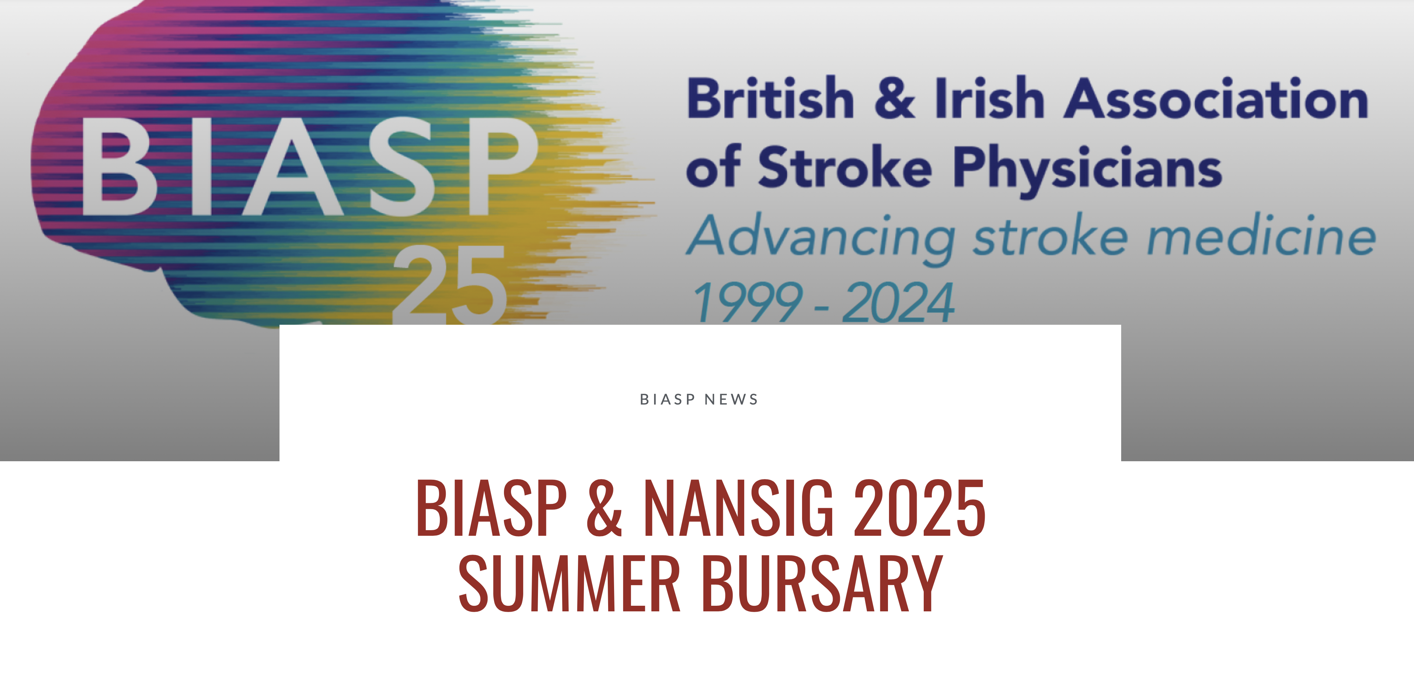
BIASP medical student bursary 2025
https://biasp.org/biasp-nansig-2025-summer-bursary/
Deadline: 31st March 2025

Slide 4
…so why should I think about stroke as a career?

Slide 5
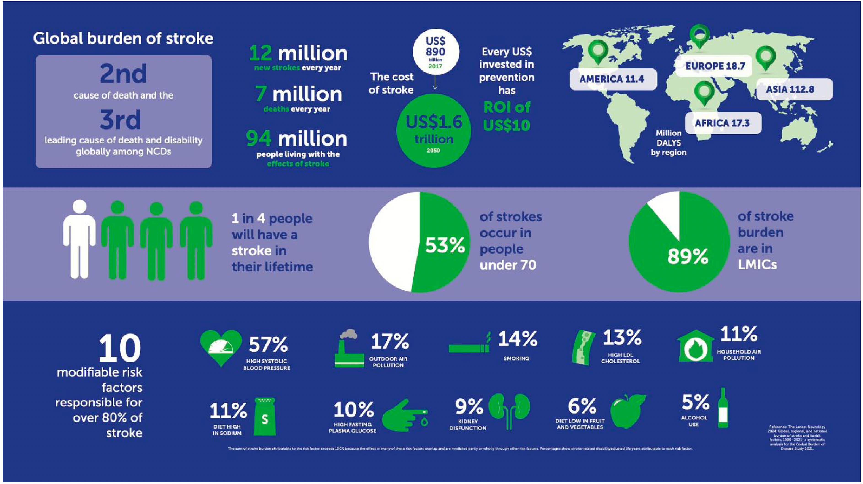
It’s important
International Journal of Stroke 2025, Vol. 20(2) 132­ –144

Slide 6
It’s exciting and treatable and has advanced at an amazing rate
THEN
“There is probably little that medical treatment can do to alter the immediate prognosis of stroke. Both fibrinolytic drugs and anti-coagulation increase the risk of intracranial bleeding and should usually not be used.”
Oxford textbook of medicine, 1983
NOW
Thrombolysis for acute ischaemic stroke
Mechanical thrombectomy for large vessel occlusion
Stroke Unit Care benefits
Carotid endarterectomy to prevent further strokes
Hemicraniectomy for malignant MCA infarction
Endovascular treatments for aneurysms, AVMs, etc.
Preventing recurrent stroke with maximum rapid medical treatment
Direct oral anticoagulants
Advanced brain imaging including MRI
Blood pressure reduction in intracerebral haemorrhage (ICH)
Minimally invasive surgery for ICH

Slide 7
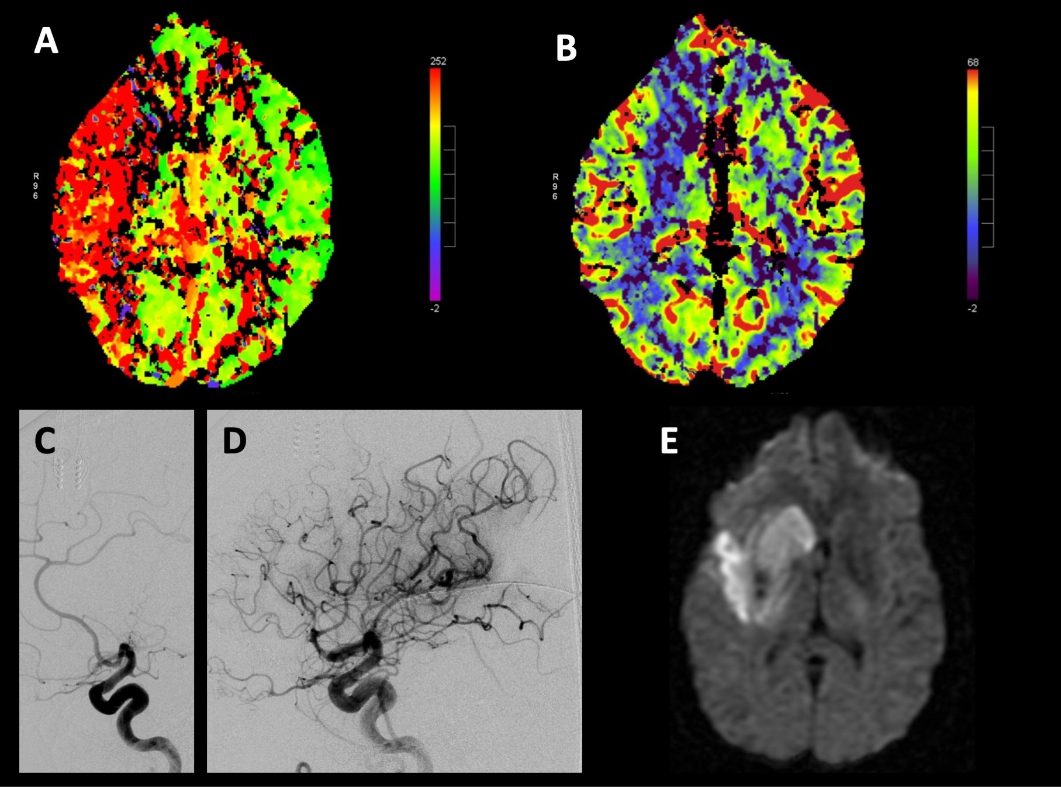
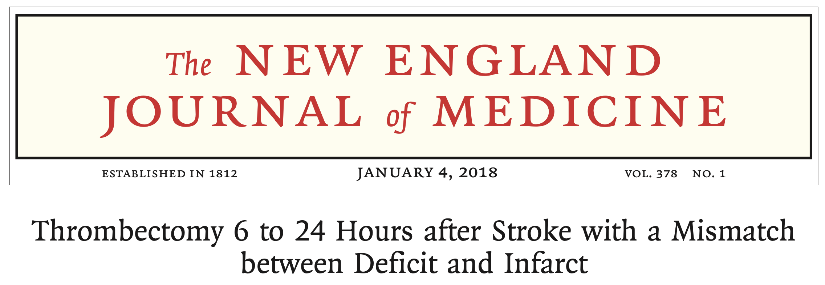
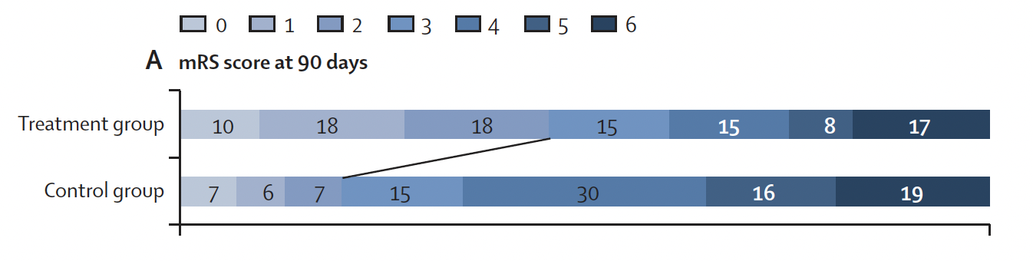
Mechanical thrombectomy
Number needed to treat to reduce disability: 2!
Good functional outcome: 46% vs 19%
Lancet 2022; 399: 249–58

Slide 8
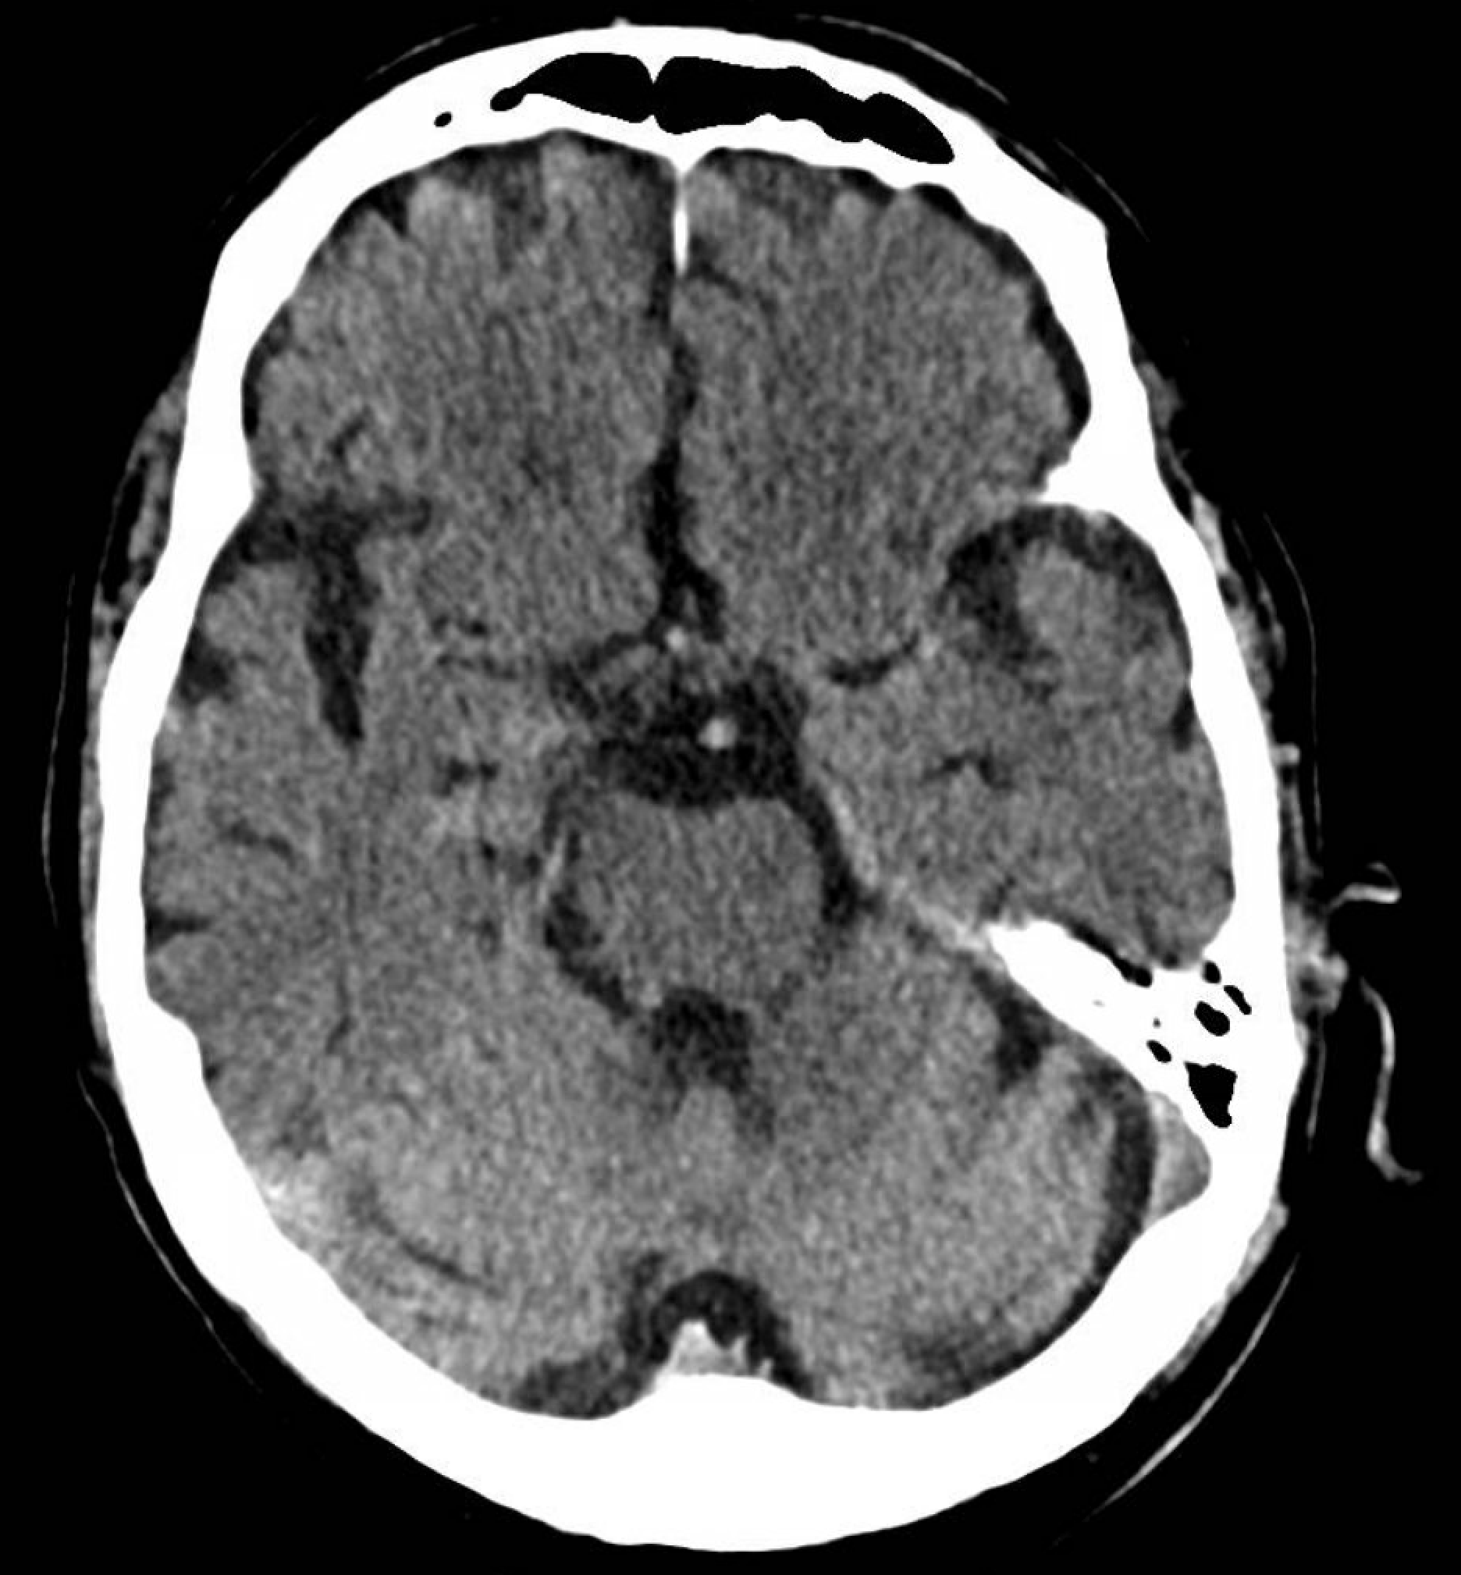
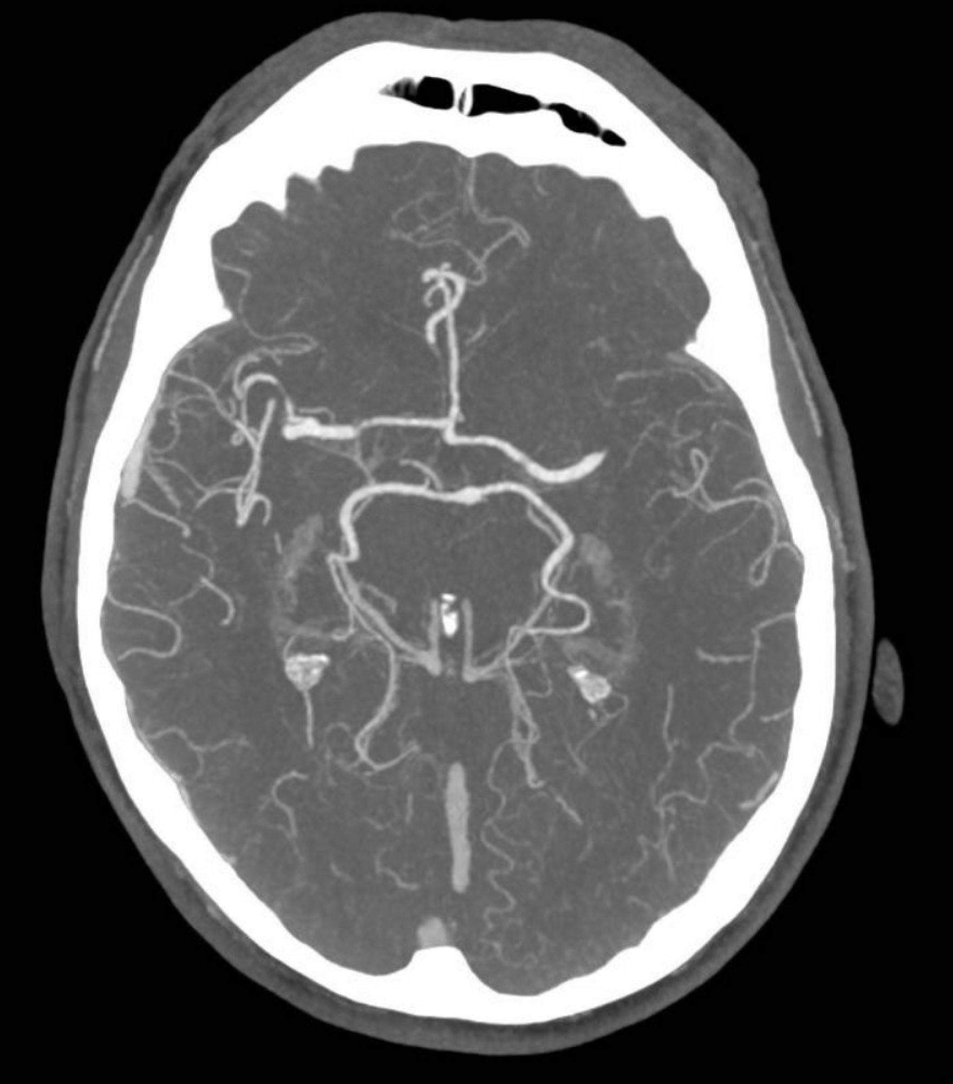
Patient admitted recently with right hemiparesis, neglect, visual field loss, dysphasia
Left M1 occlusion of the middle cerebral artery

Slide 9
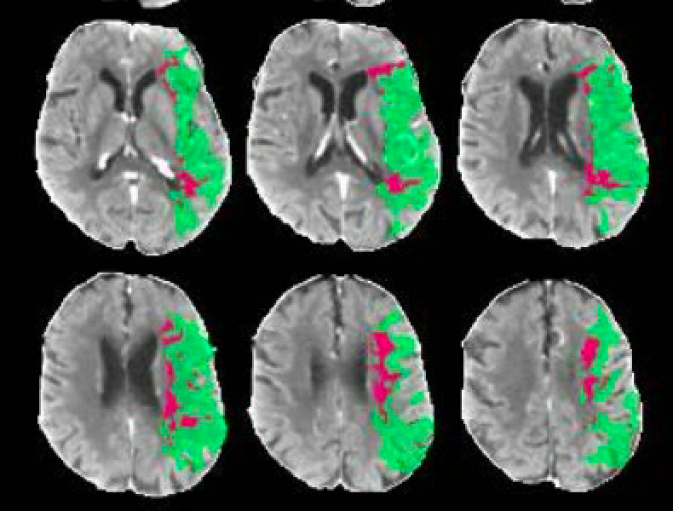
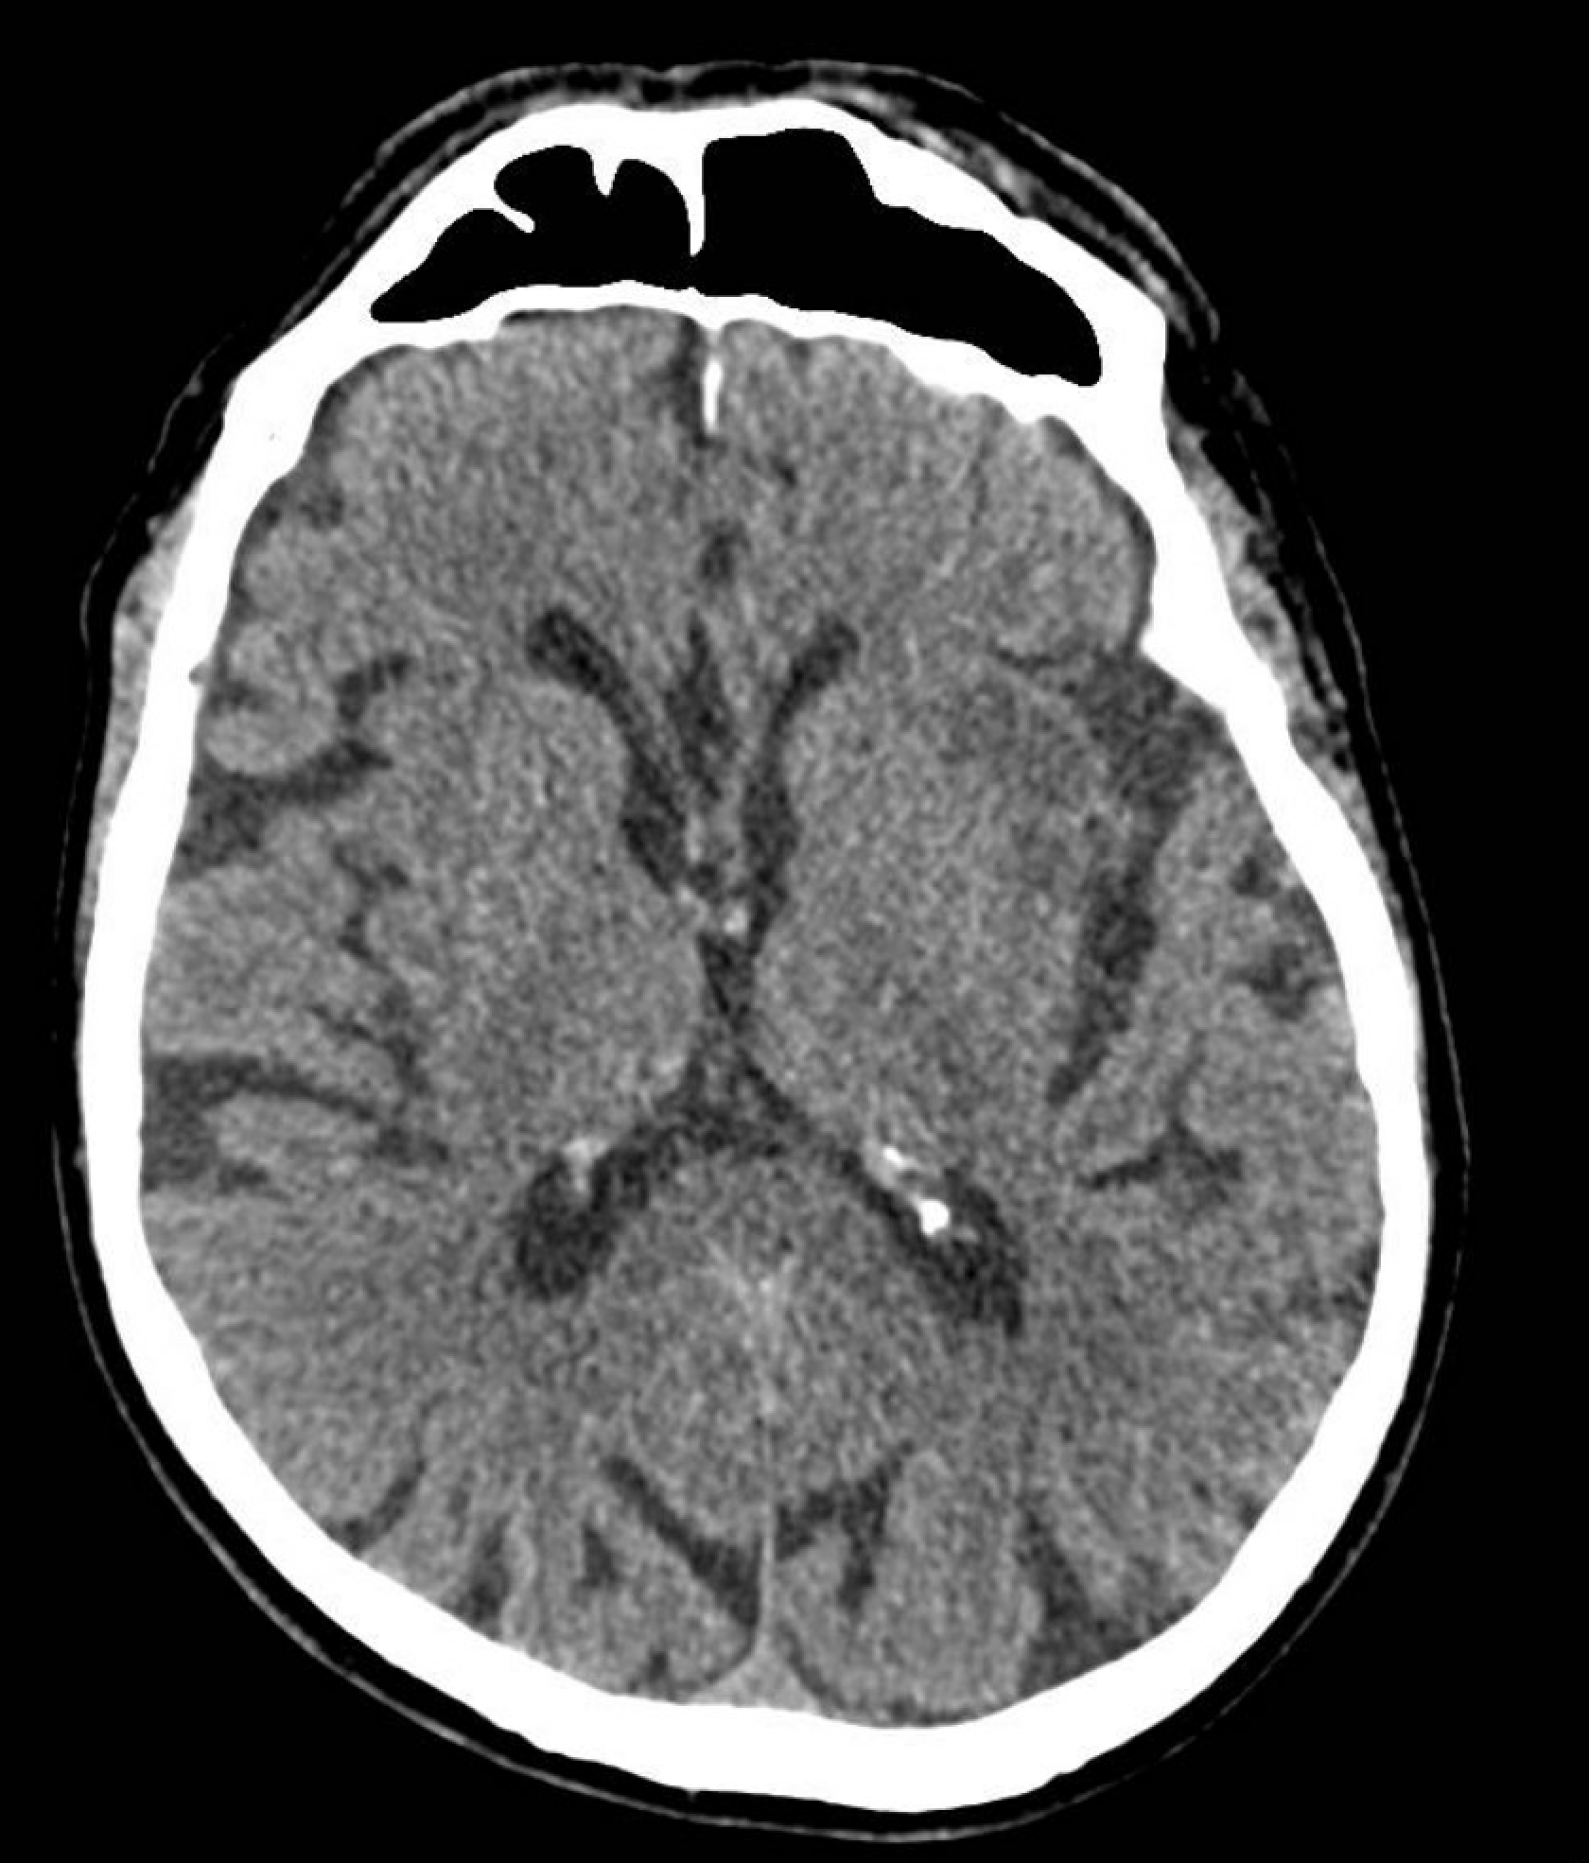
CT perfusion showed salavageable tissue with a large penumbra
Made a full recovery (NIHSS 0) and was able to leave hospital after 48h!
CT head showed only a small infarct after mechanical thrombectomy

Slide 10
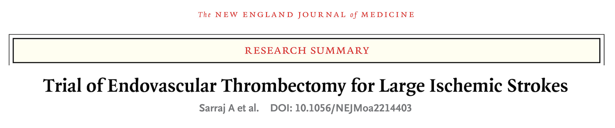
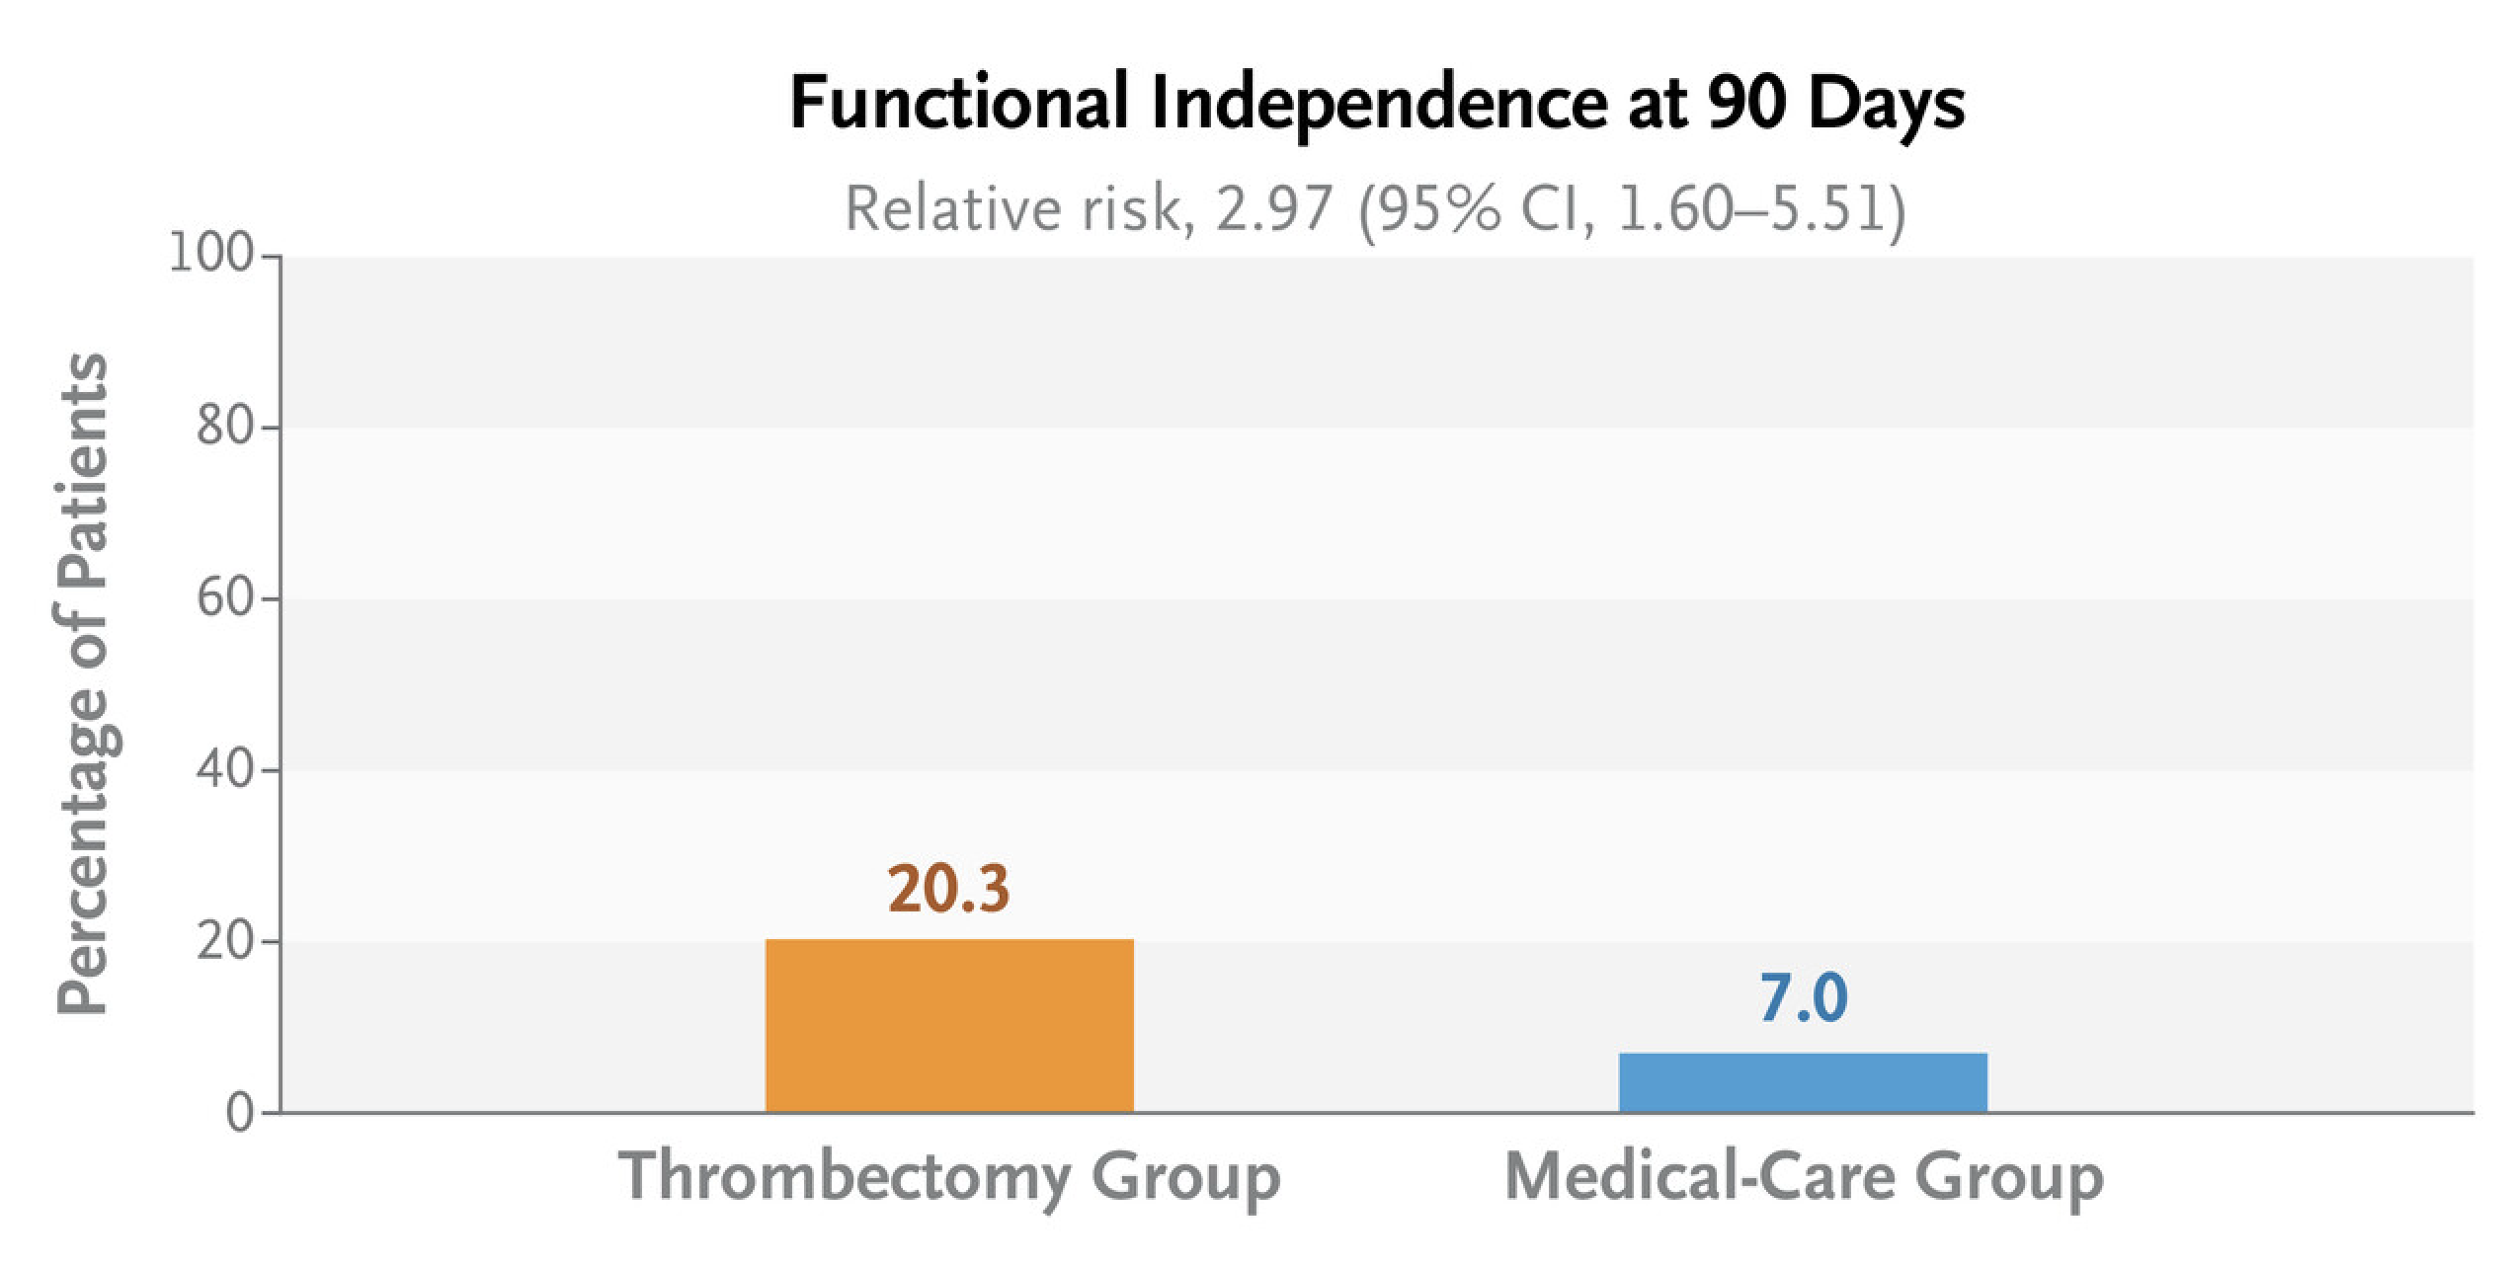
It is a very exciting and rapidly changing field!

Slide 11
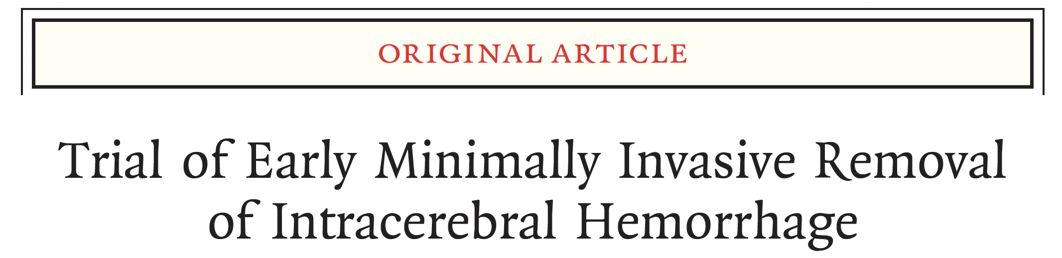
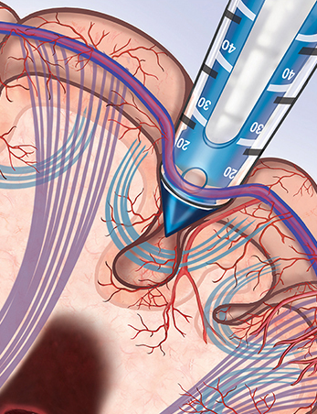
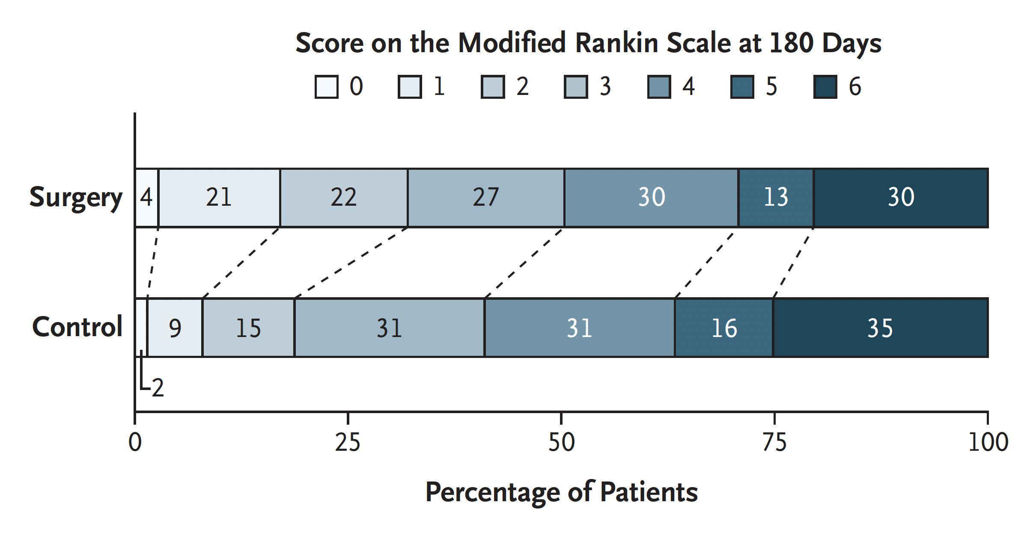
N Engl J Med 2024;390:1277-89.

Slide 12
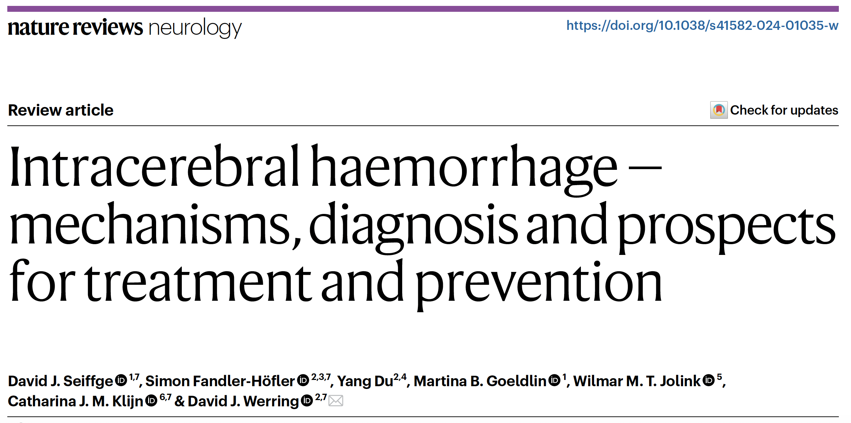
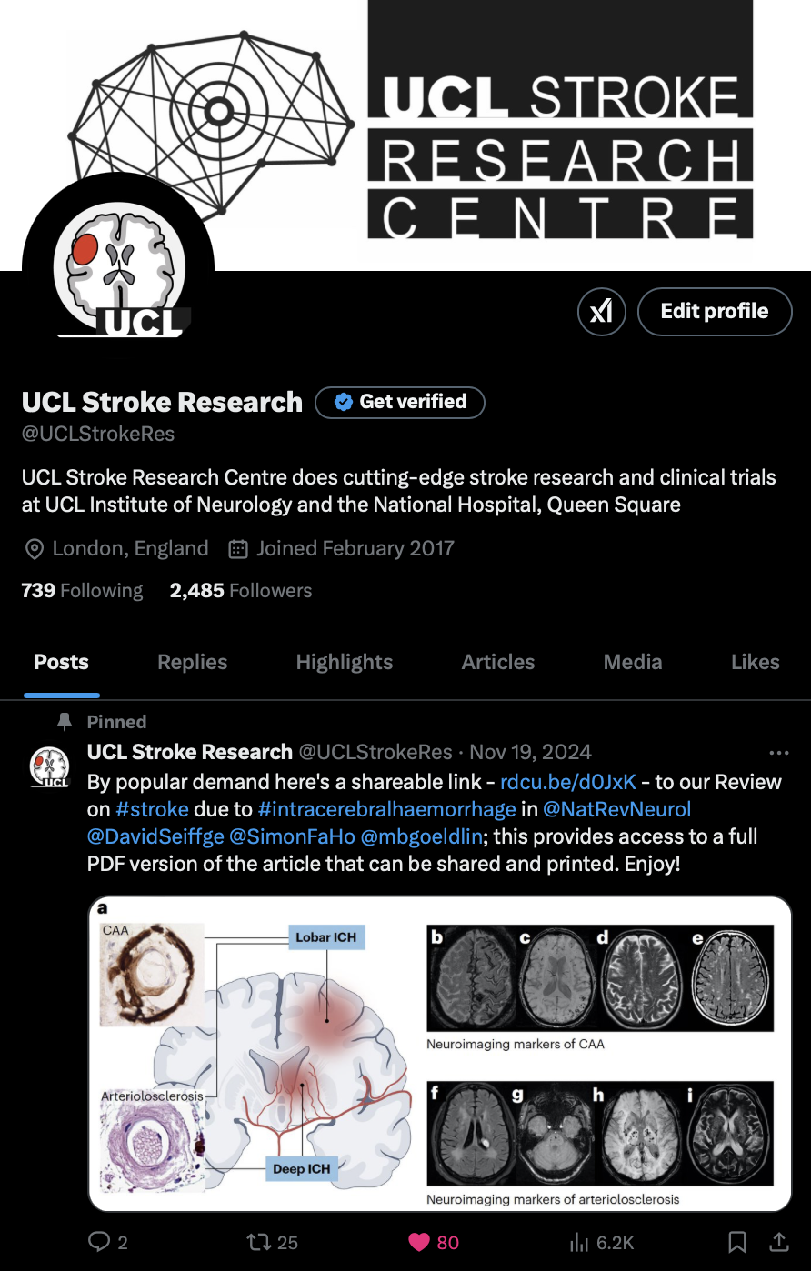
Further reading
Free shareable link: rdcu.be/d0JxK
@UCLStrokeRes

Slide 13
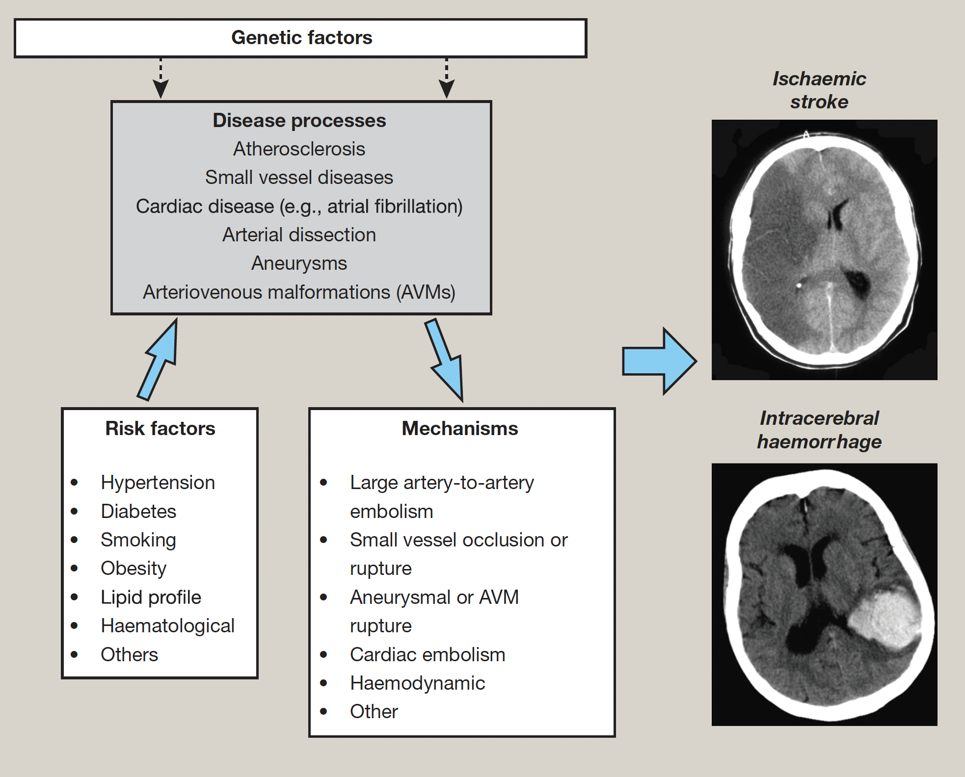

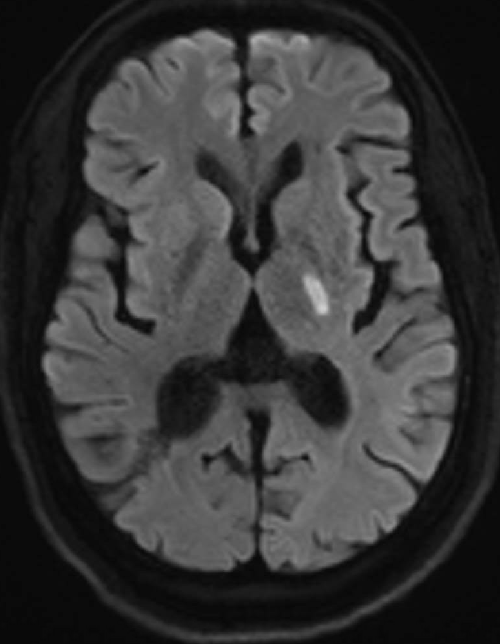
It’s really interesting
‘speed neurology’
It’s hugely varied and not really a single disease!

Slide 14
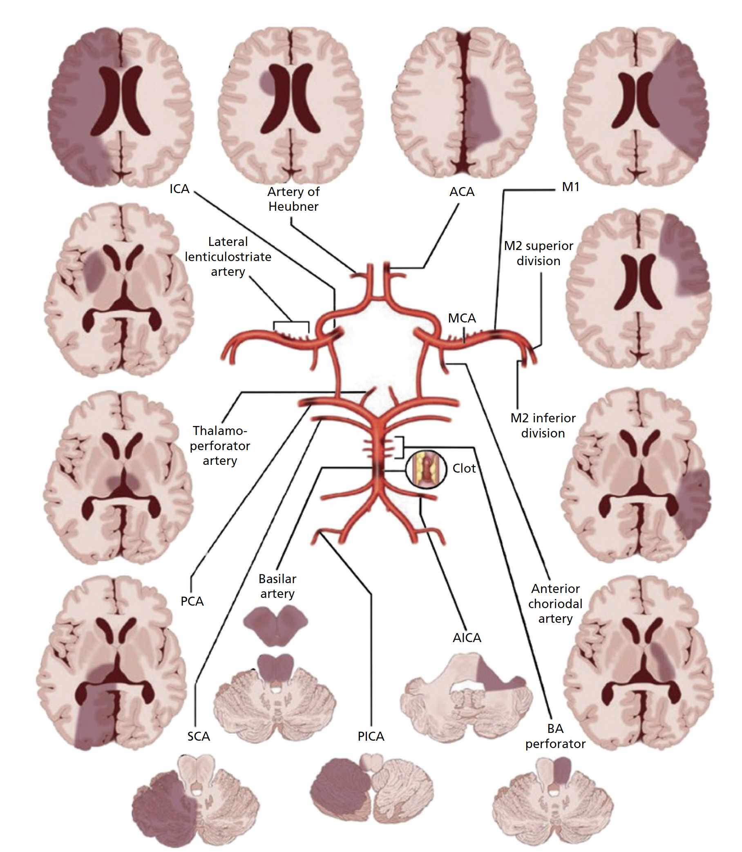
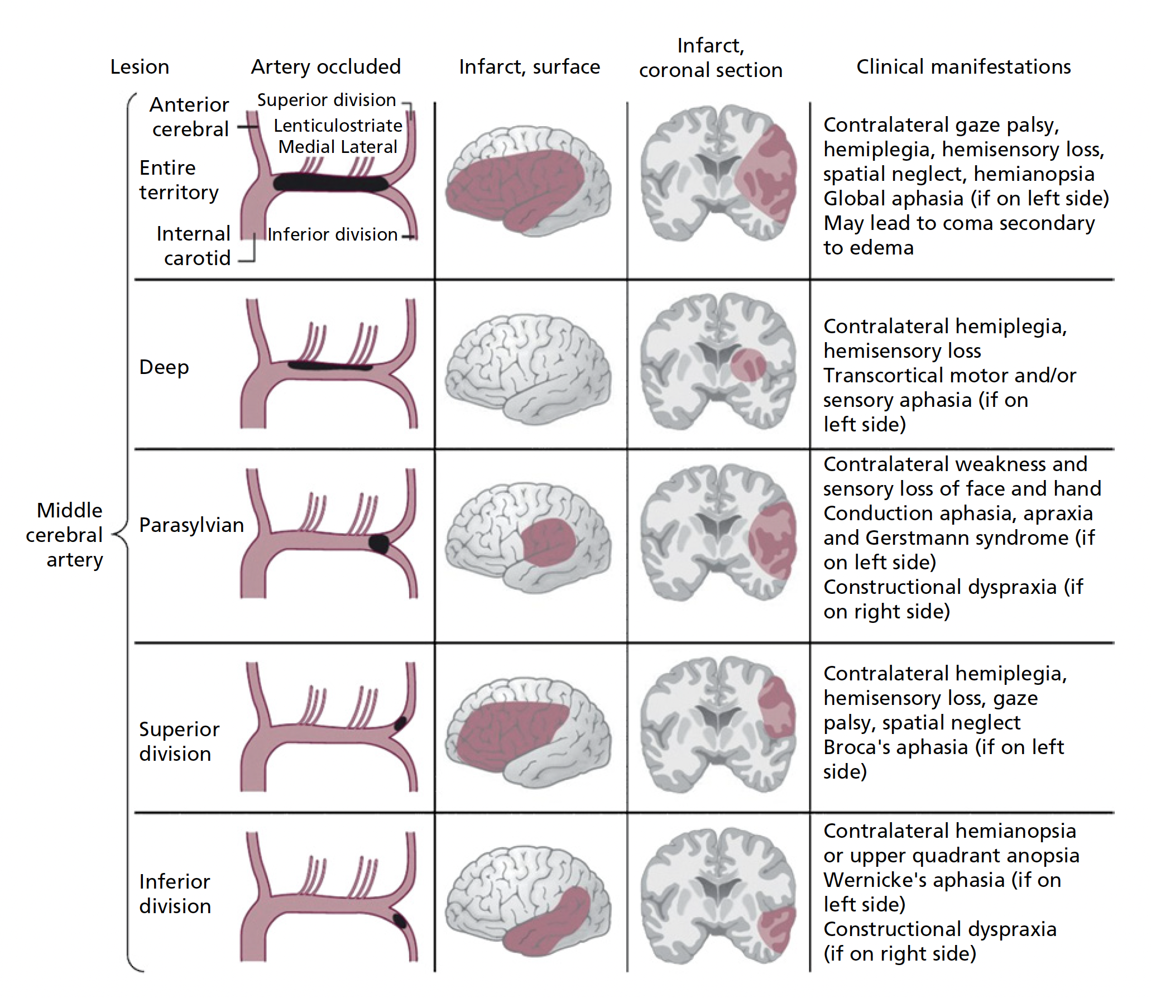
There is no better way to learn!
You learn neurology ‘stroke by stroke’
C Miller Fisher

Slide 15
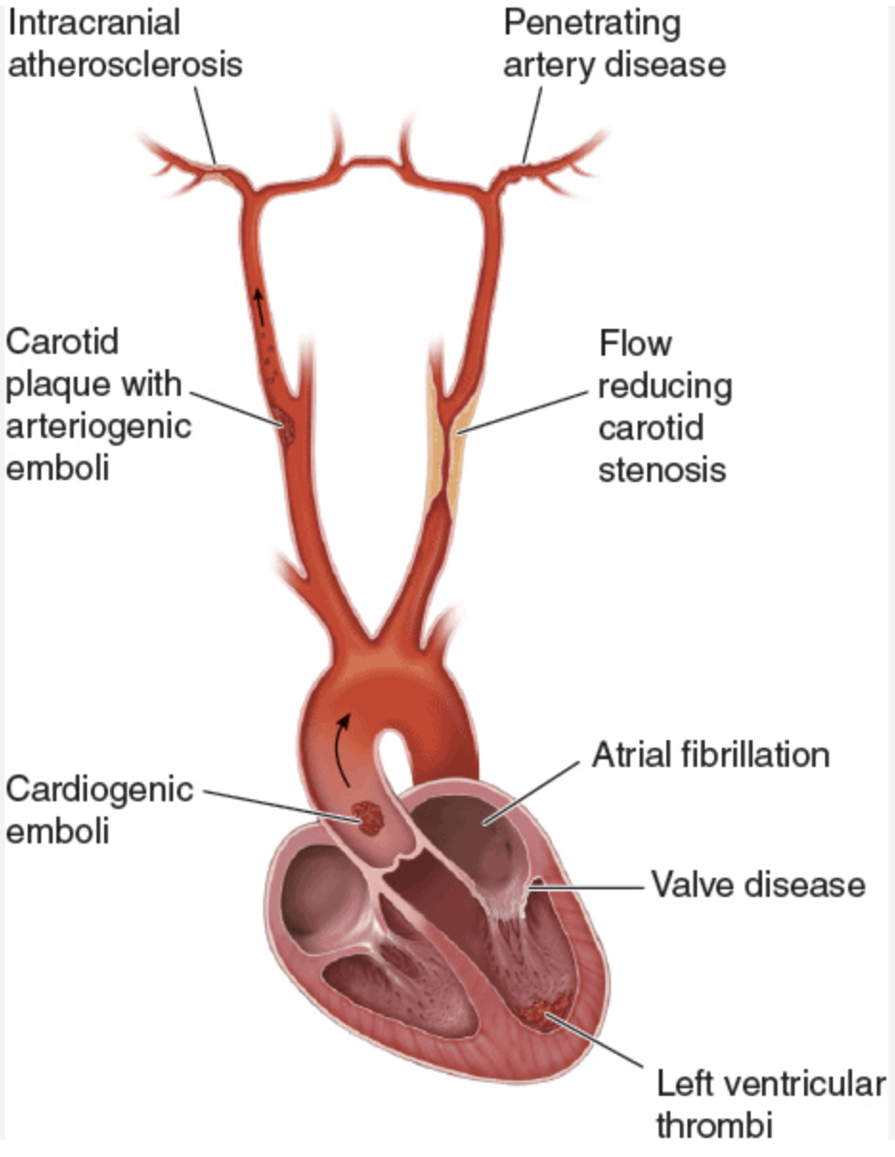
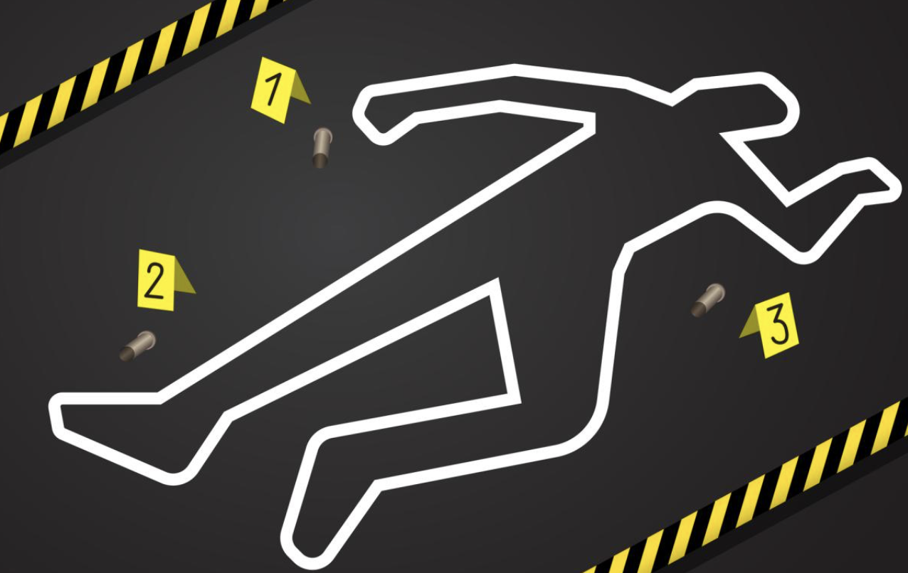
Stroke isn’t an accident – determining the cause is critical and a major part of the specialty and endlessly fascinating
cerebrovascular accident (CVA)

Slide 16
It’s a very varied job
Acute diagnosis and care in ED, resus, HASU
TIA and acute neurology clinics
Rehabilitation ward round
Family meetings about complex ethical decisions e.g., tube feeding, lasting power of attorney, etc.
End of life care
Treat patients of all ages
Work with many other medical teams (neuroradiology, neurosurgery, haematology, cardiology, etc.)
Secondary prevention or complex follow-up

Slide 17
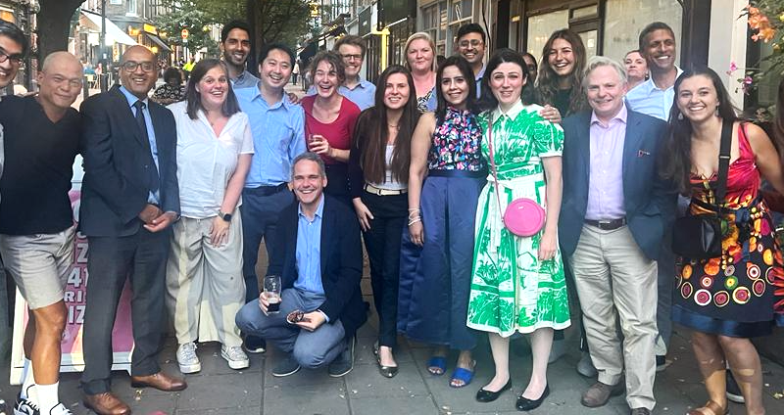
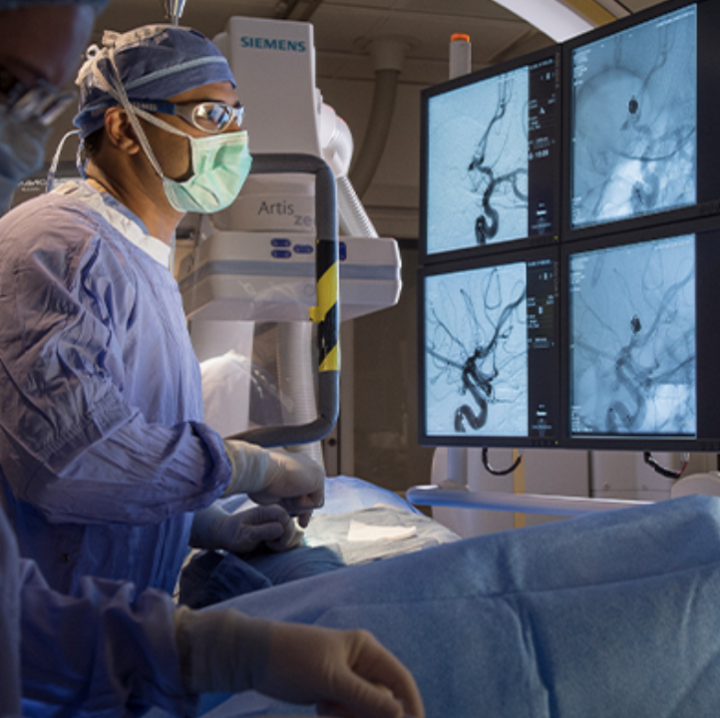
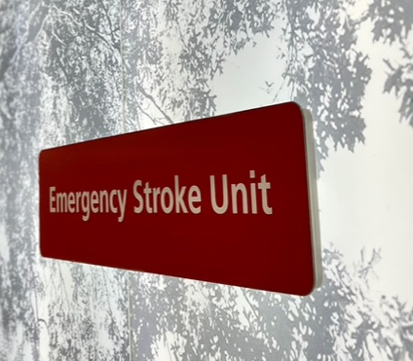
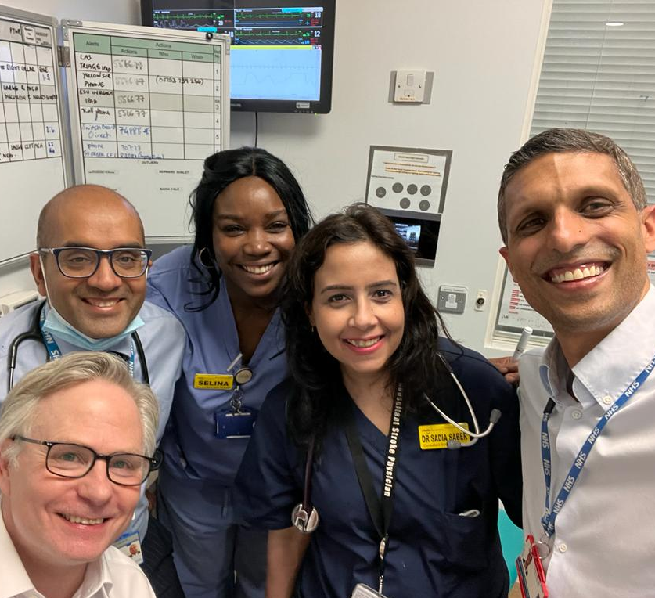
It’s a great example of teamwork…

Slide 18
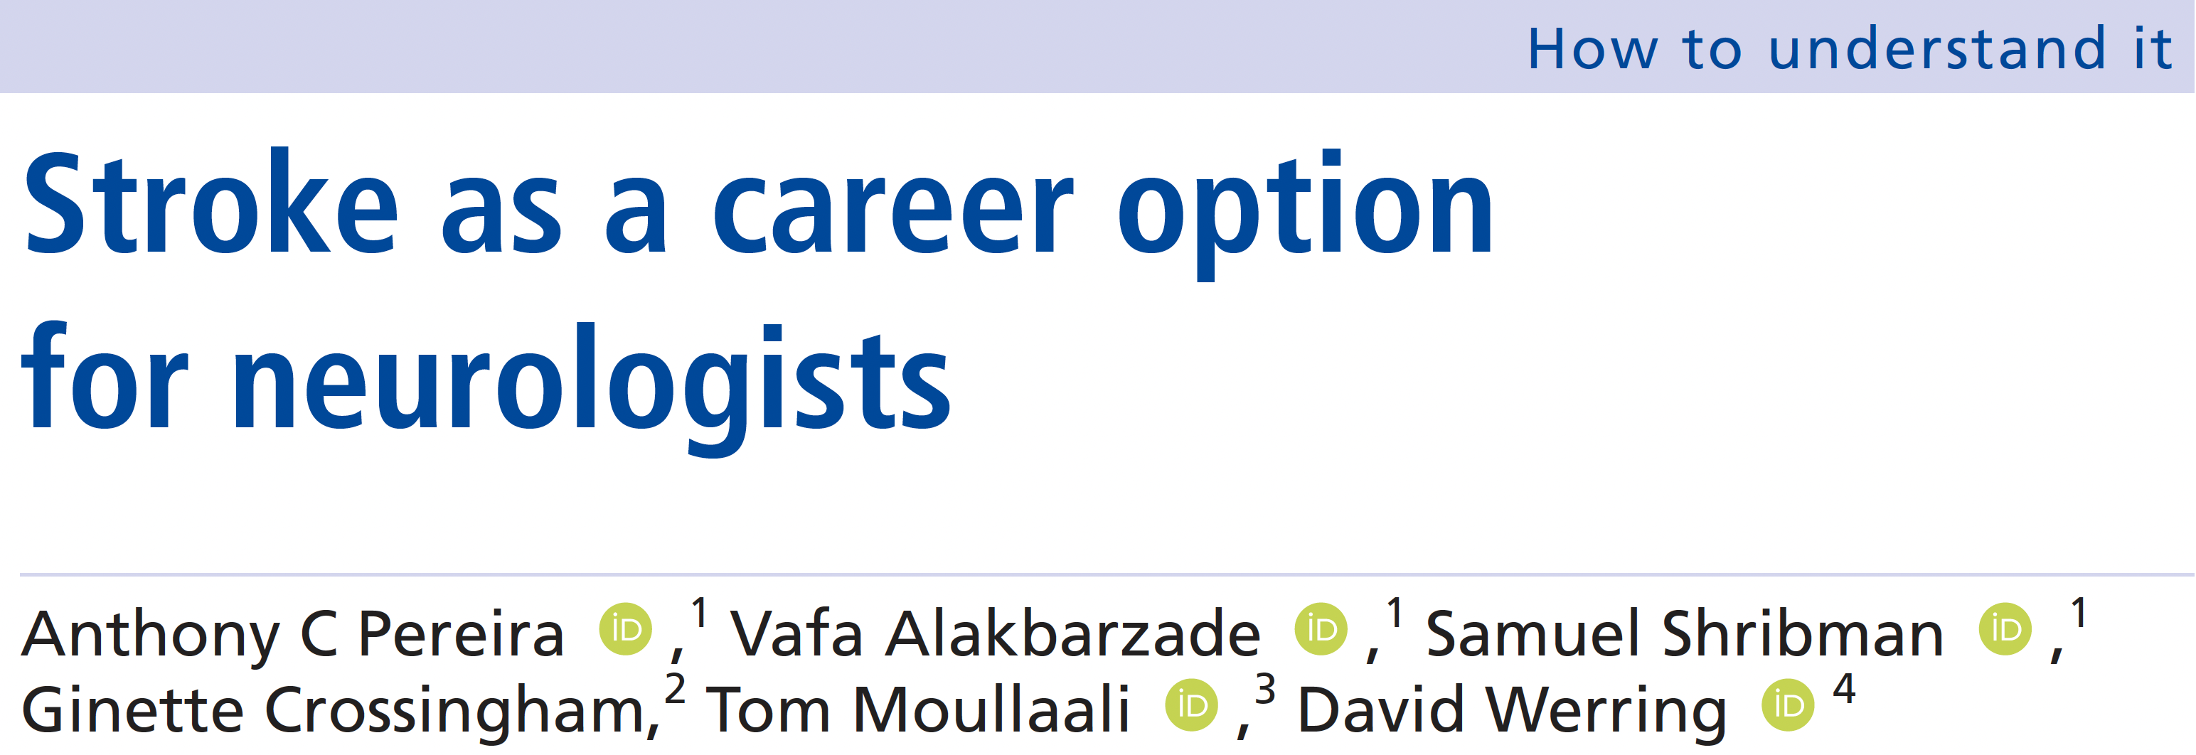
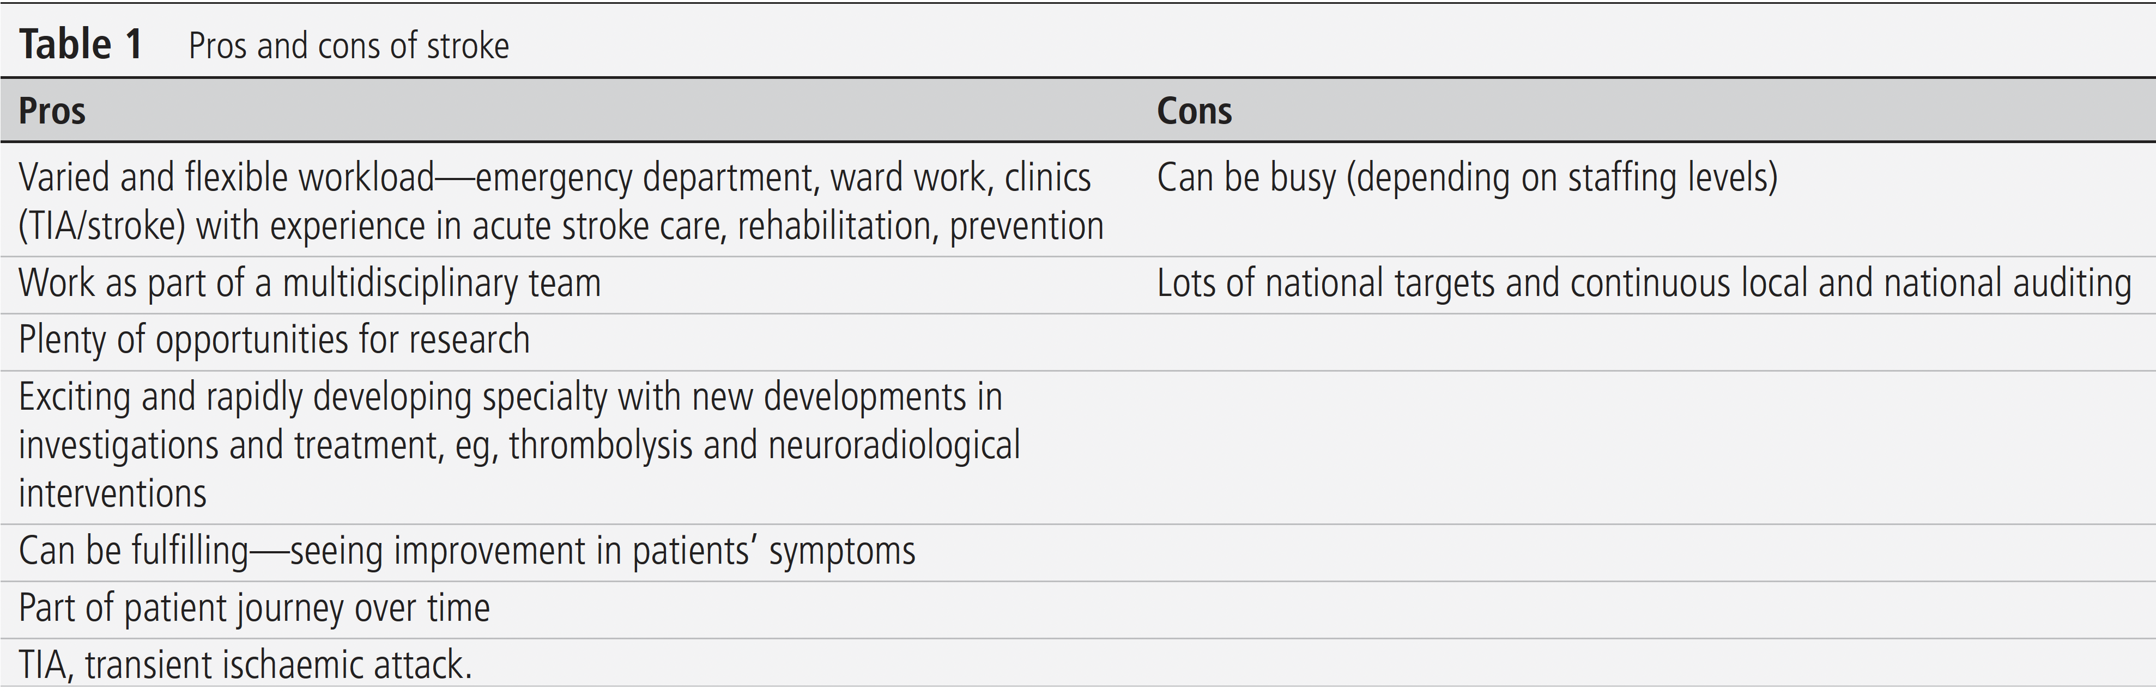

Slide 19
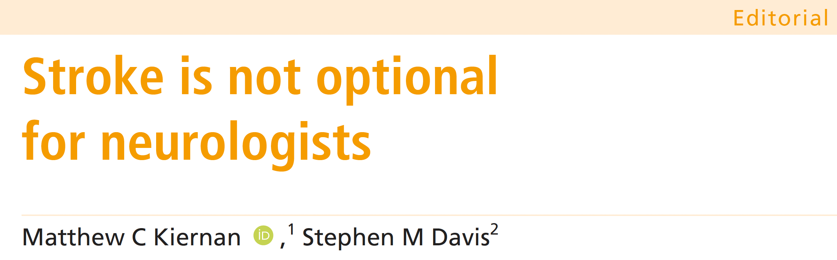
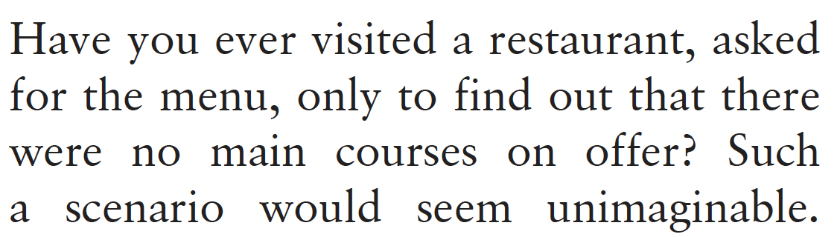

Slide 20
Training pathways are flexible
Completion of foundation programme
Completion of core training programme e.g., IMT
Entry is possible via several specialties
  Acute medicine
  Geriatric Medicine
  Neurology
  Rehabilitation Medicine
  Clinical pharmacology
For more details please see: https://biasp.org/career-in-stroke/

Slide 21
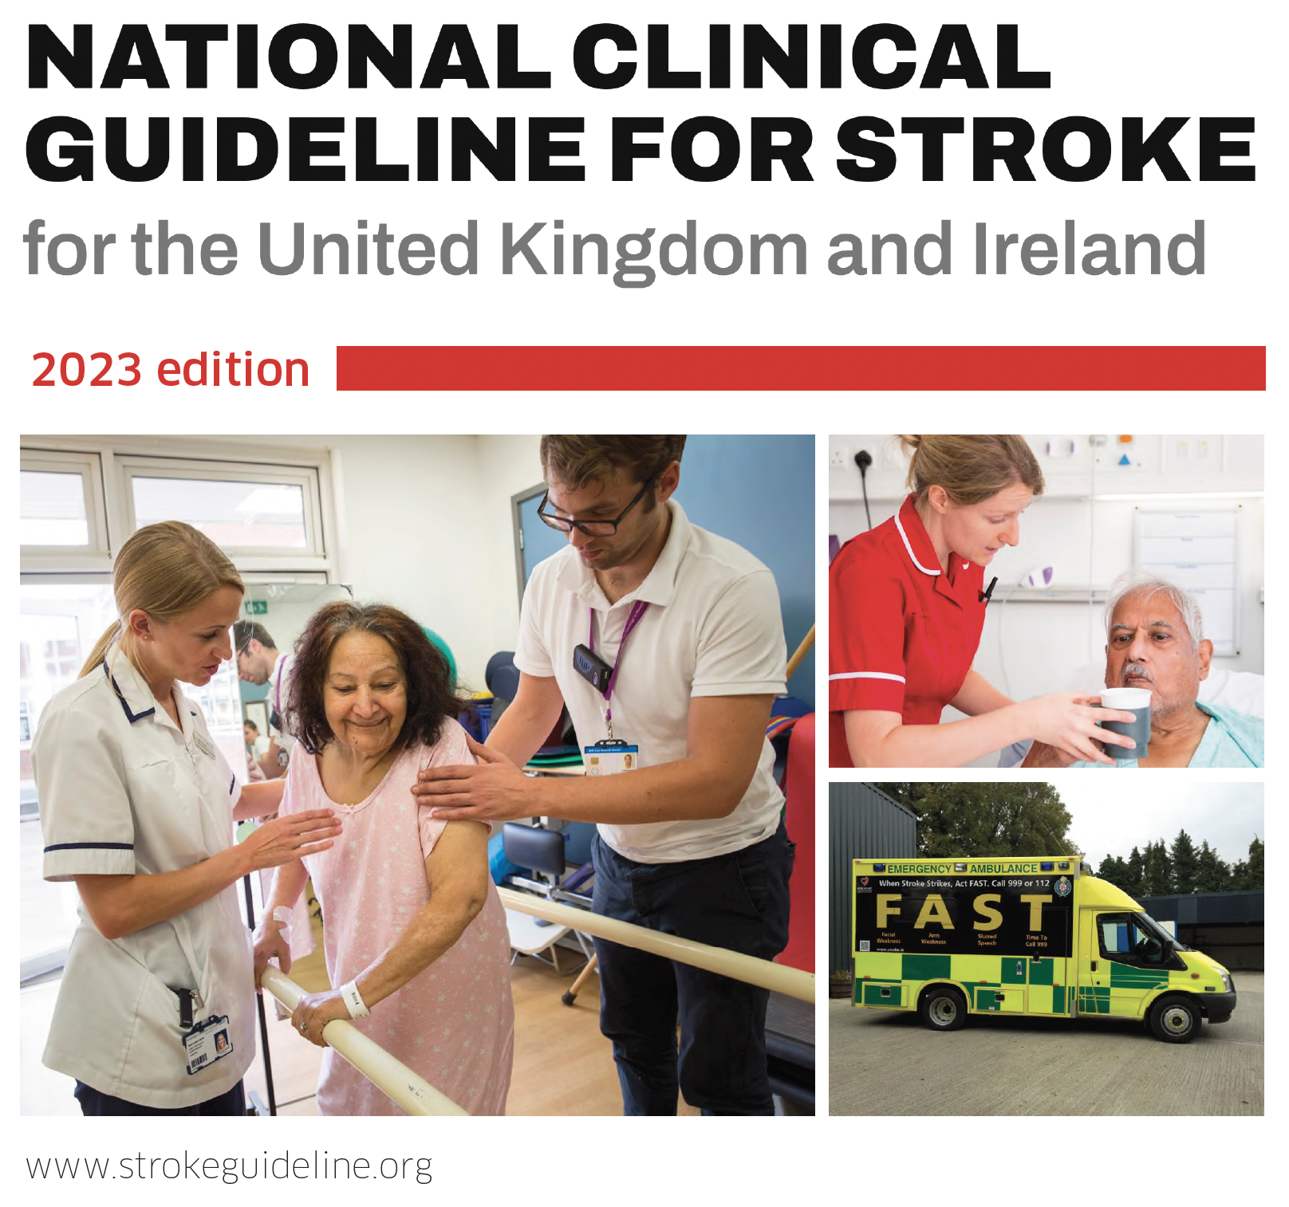
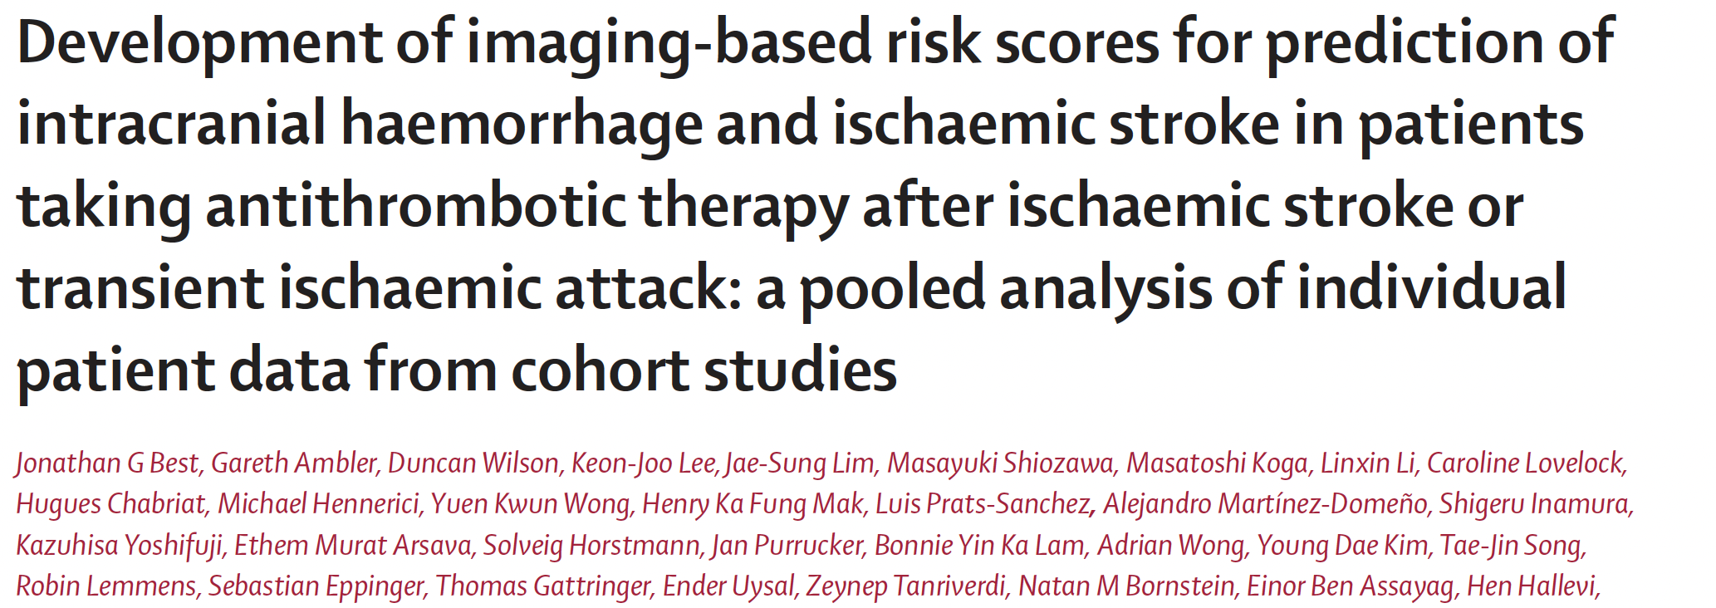
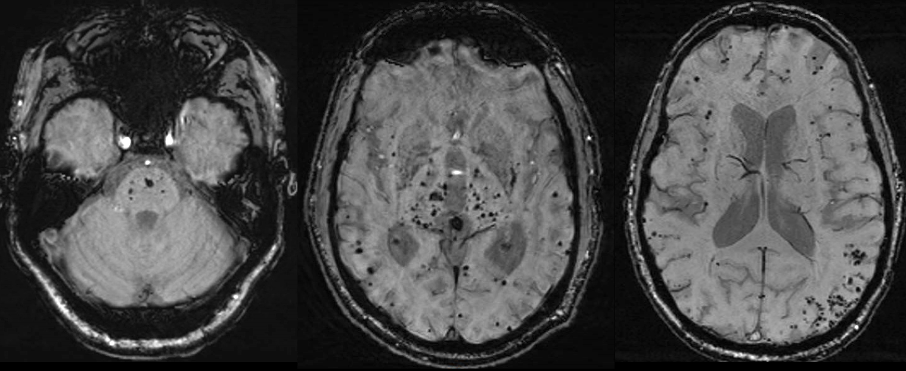
It provides great research opportunities
…and discoveries can rapidly translate to improved care

Slide 22
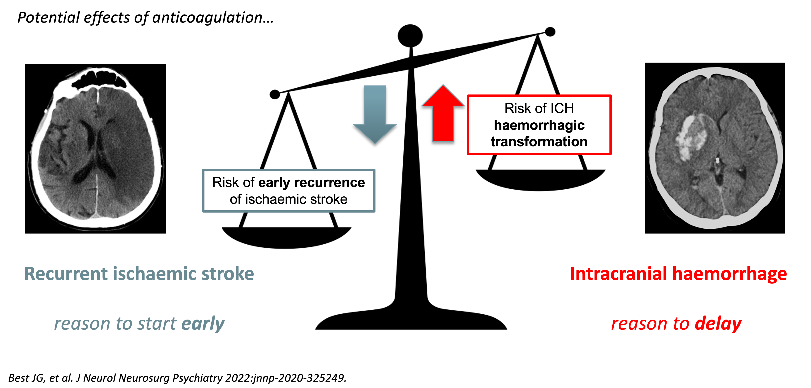
A common dilemma on the stroke unit for many decades…

Slide 23
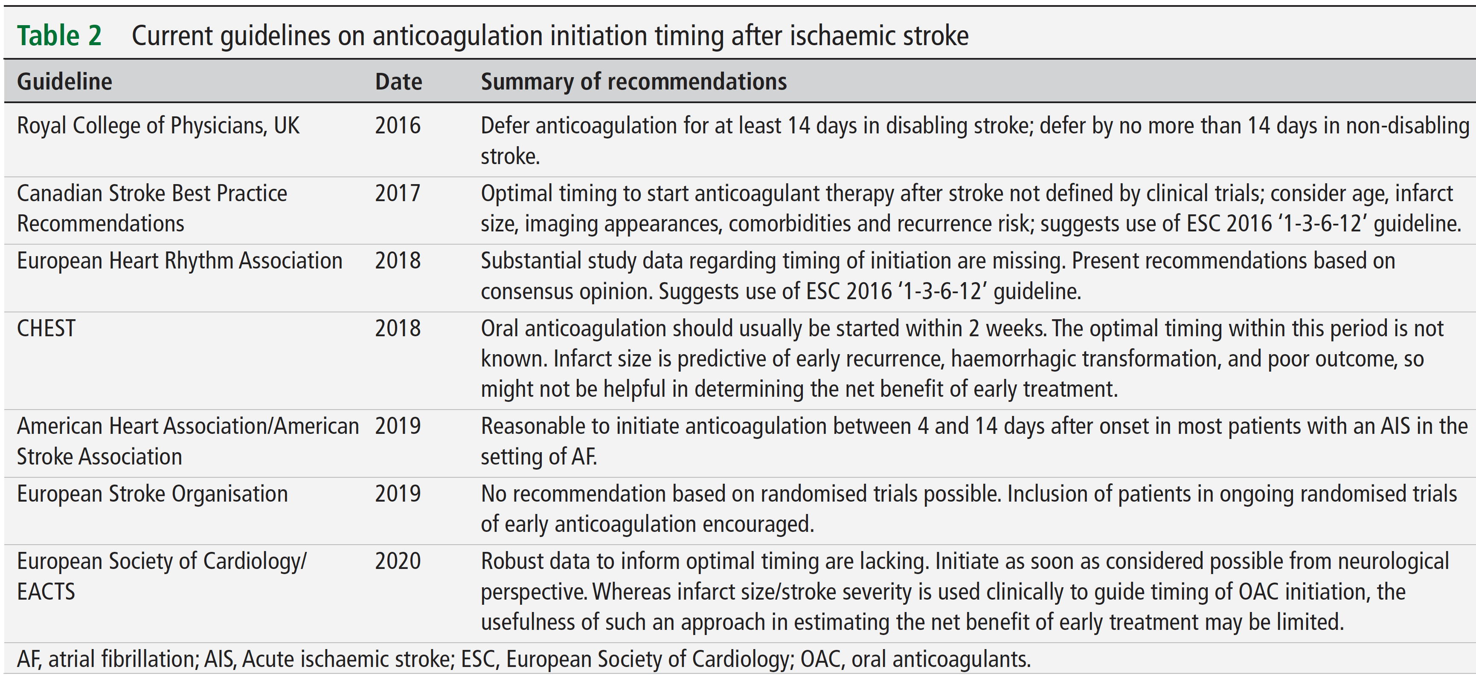
Recent guidelines are inconsistent
Best JG, et al. J Neurol Neurosurg Psychiatry 2022;93:939–51.

Slide 24
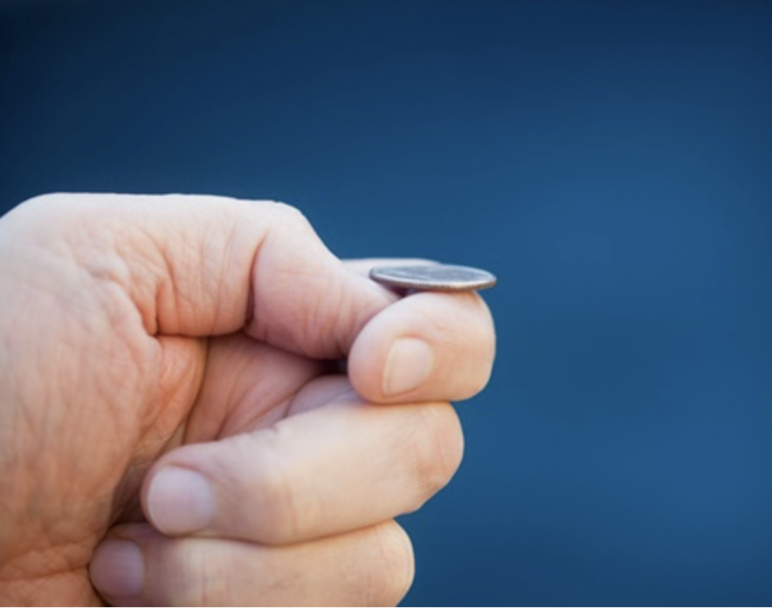
A common dilemma on the stroke unit for many decades…
If in doubt about the best treatment… RANDOMISE!

Slide 25
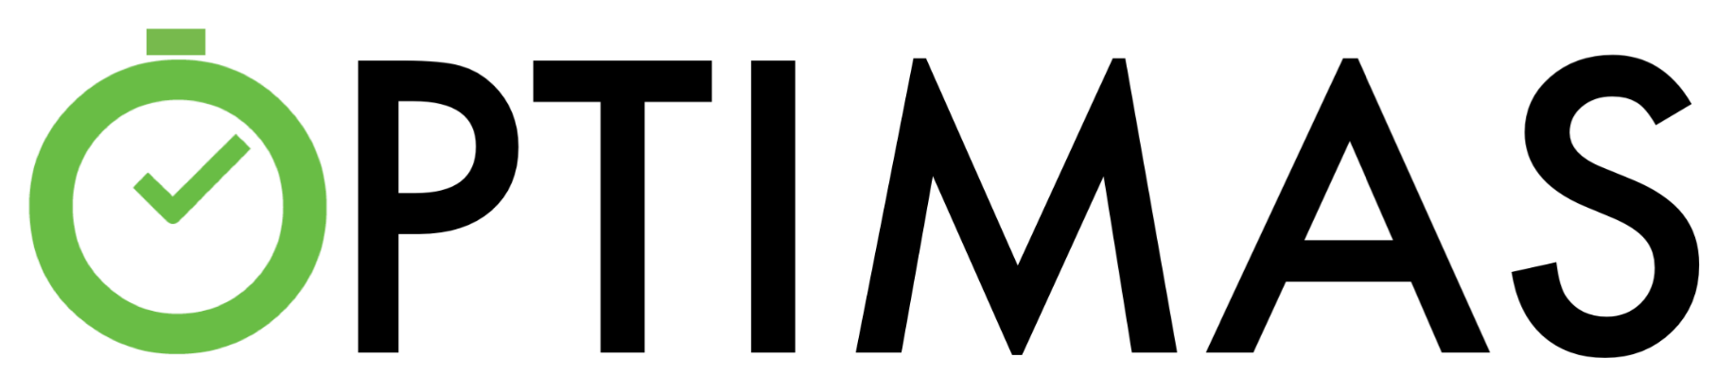
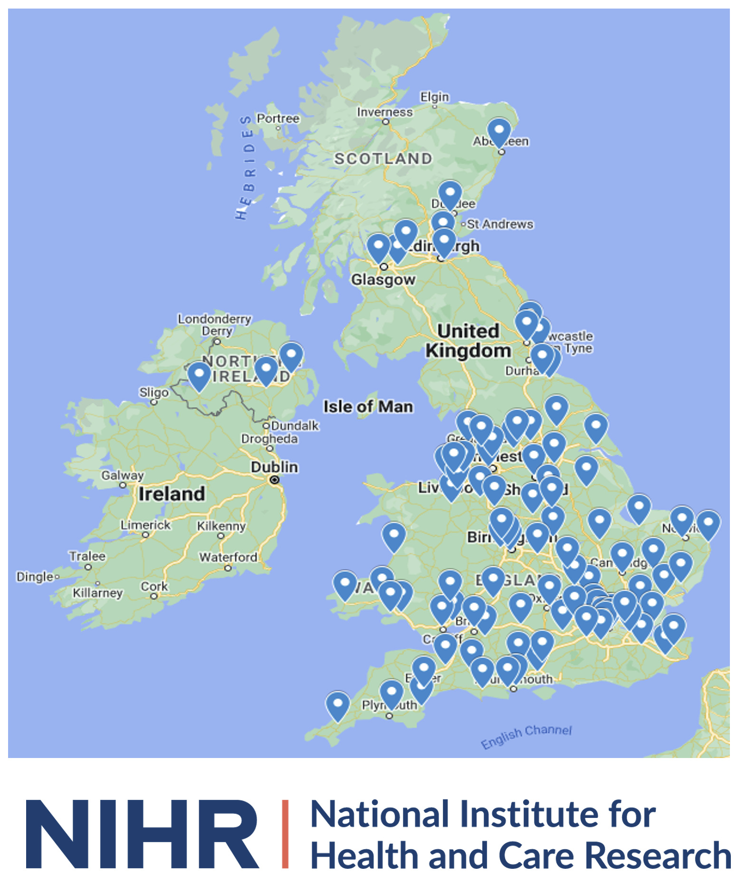
Participants with acute ischaemic stroke and AF
Randomisation
1:1
Intervention (early)
initiation of licensed oral dose of a DOAC within 4 days [96 hours]* of acute ischaemic stroke onset
Control (delayed)
initiation of licensed oral dose of a DOAC between 7 and 14 days [144-336 hours]* of acute ischaemic stroke onset
Follow-up for the primary outcome
composite of ischaemic stroke, symptomatic intracranial haemorrhage, or systemic embolism at 90 days
*the exact timing of initiating treatment within each group is at the discretion of the treating clinician

Slide 26
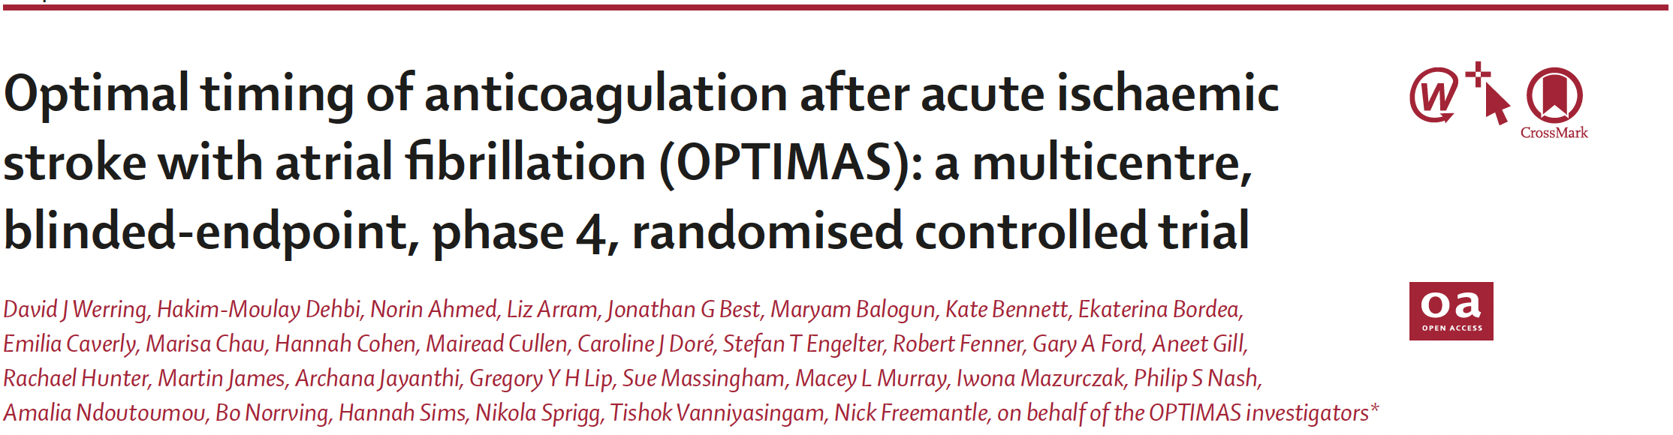
https://doi.org/10.1016/S0140-6736(24)02197-4

Slide 27
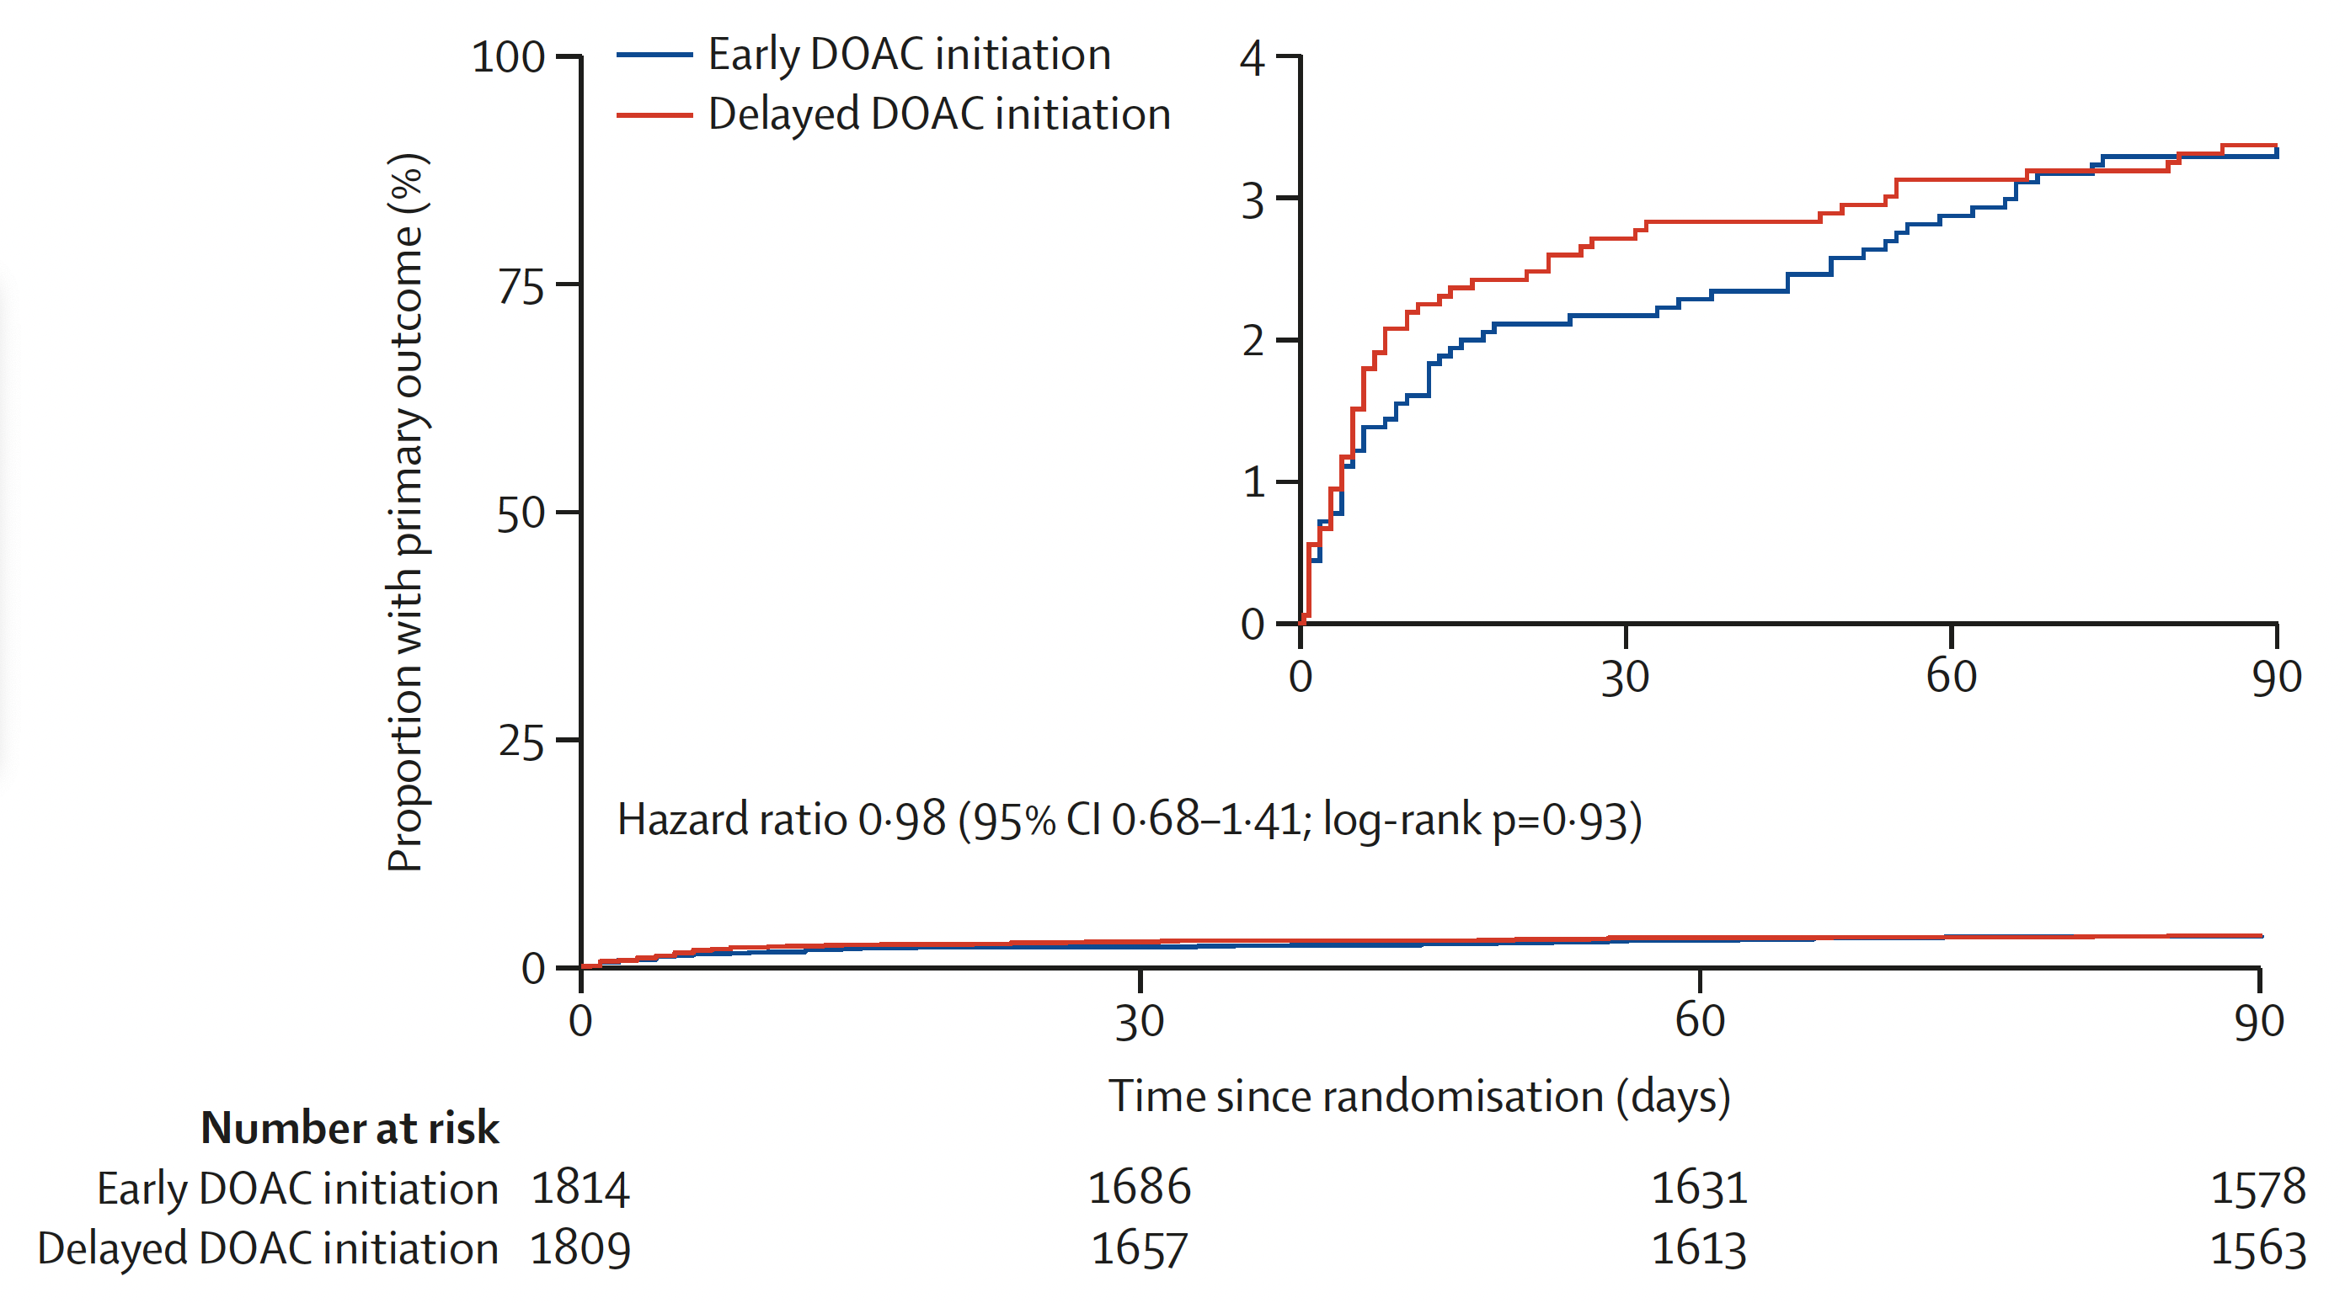
Early treatment was just
as good as delayed treatment
No need to delay as per guidelines!
https://doi.org/10.1016/S0140-6736(24)02197-4

Slide 28
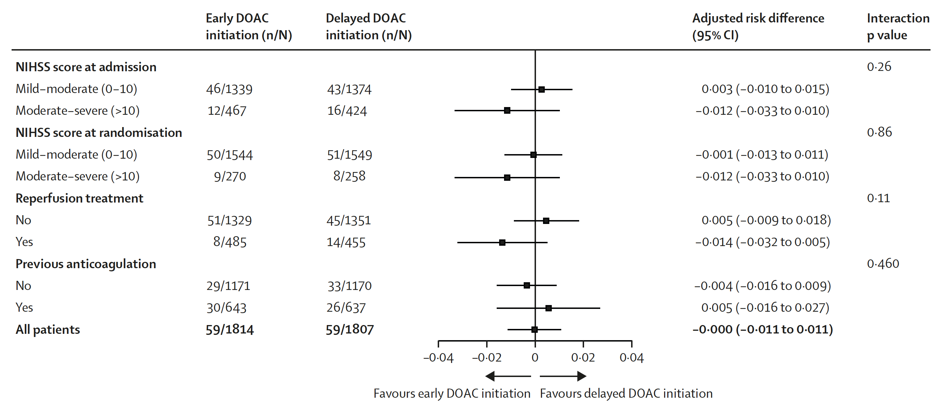
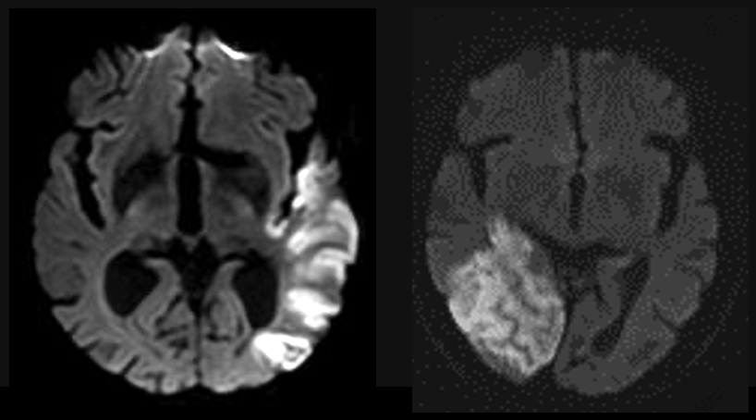
Early treatment was safe, even for people with severe stroke syndromes
https://doi.org/10.1016/S0140-6736(24)02197-4

Slide 29
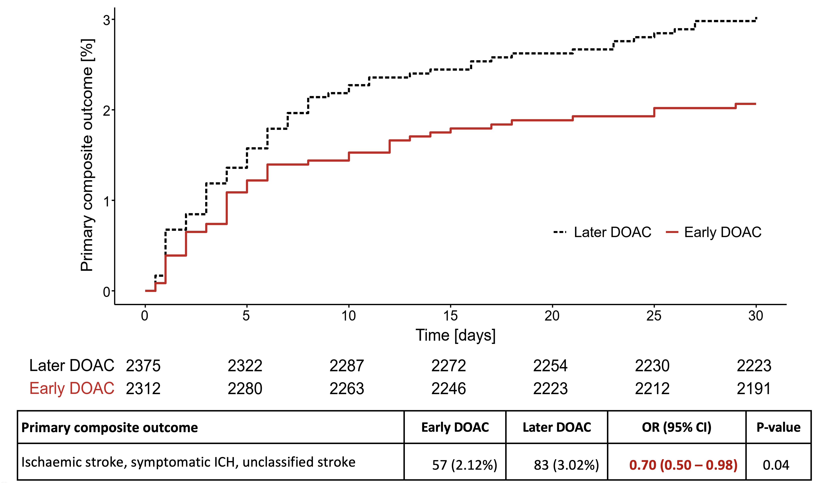
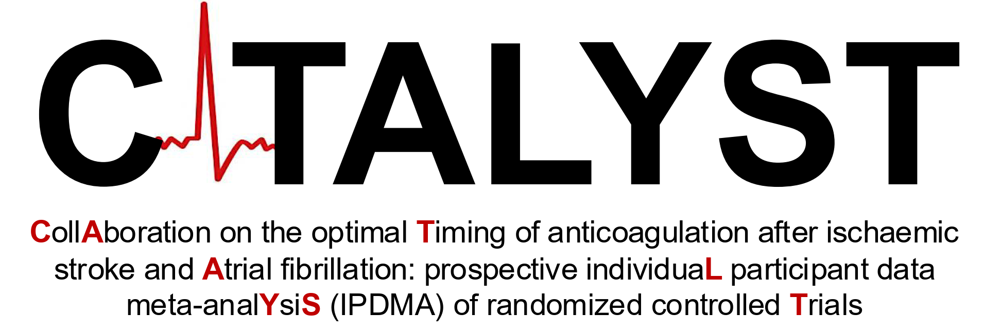
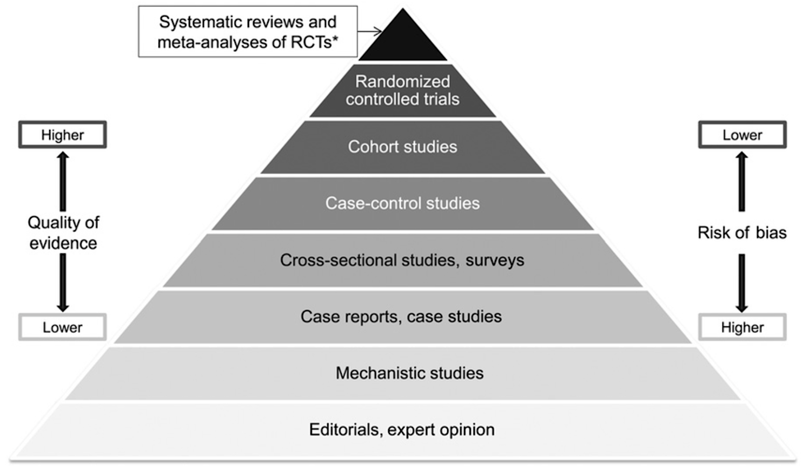
Meta-analysis of all trials

Slide 30
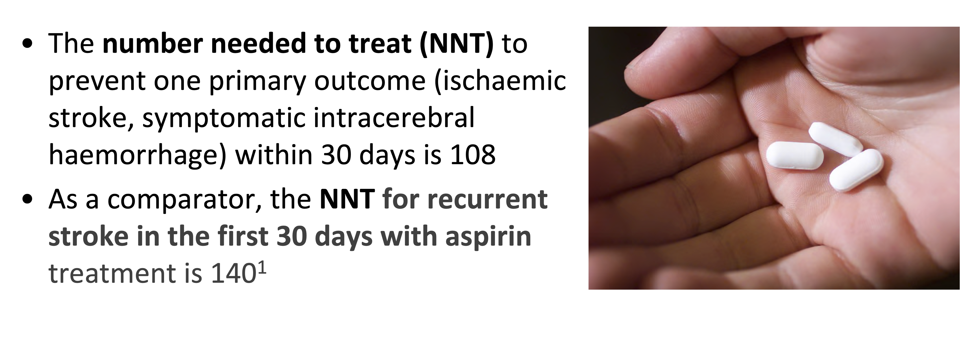
What do these results mean?
1. Sandercock PAG, Counsell C, Gubitz GJ, Tseng MC. Antiplatelet therapy for acute ischaemic stroke. Cochrane Database of Systematic Reviews 2008, Issue 3. Art No.: CD000029.

Slide 31
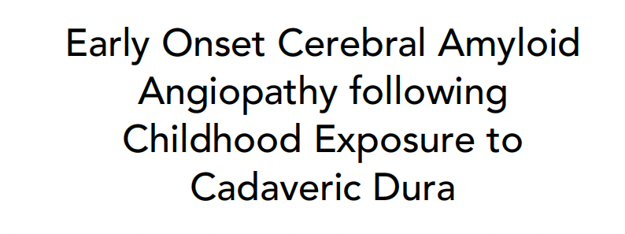




…research findings can also be unexpected
https://doi.org/10.1136/jnnp-2024-335164
ANN NEUROL 2019;85:284–290

Slide 32



Slide 33
Summary: why stroke?
It’s exciting and treatable: you can make a huge difference
It has advanced rapidly in recent decades
It’s important
It’s really interesting
It isn’t one disease so is fascinating (and isn’t an accident!)
It’s a very varied job
It’s a great example of teamwork (including with neurosurgery, neuroradiology, allied health professinals)
It has great research opportunities
It is great fun! (…most of the time)

Slide 34
Working with NANSIG
BIASP now confirmed as an affiliate organization
BIASP members are represented within NANSIG
Our members can facilitate NANSIG projects - e.g., DATES
BIASP events open to NANSIG members – e.g., annual stroke trainees meeting (spring), NIHR stroke research workshop (autumn)
NANSIG are now represented on BIASP committees
Successful NANSIG-BIASP virtual stroke careers day (2024)
BIASP stroke student summer bursaries

Slide 35


BIASP’s membership is thriving: there has never been a better time to join!
934
February 2025

Slide 36
BIASP medical student bursary 2025
https://biasp.org/biasp-nansig-2025-summer-bursary/
Deadline: 31st March 2025

Slide 37

Join us!
Student membership is completely free!
Excellent educational resources including webinars
Newsletter
Medical student essay prize
Medical student summer bursaries 2025

Slide 38

Thank you! questions?
www.biasp.org
Join us!
d.werring@ucl.ac.uk
@UCLStrokeRes
https://www.ucl.ac.uk/stroke/

Slide 39
BIASP’s mission is to advance stroke medicine for the good of the public, patients and professionals
Student membership is completely free!

